Slide 1


Strategic use of
Generative AI
introduction
Alexander Botzki and Bruna Piereck
This material was inspired by “Generative Artificial Intelligence (GenAI) overview” from Waterloo university v1.0 Mckensie MA, et al 2024
Speakers note and links can be found in most slides of this presentation in the notes portion of the slide.
_______C C B Y 4.0_______

Slide 2
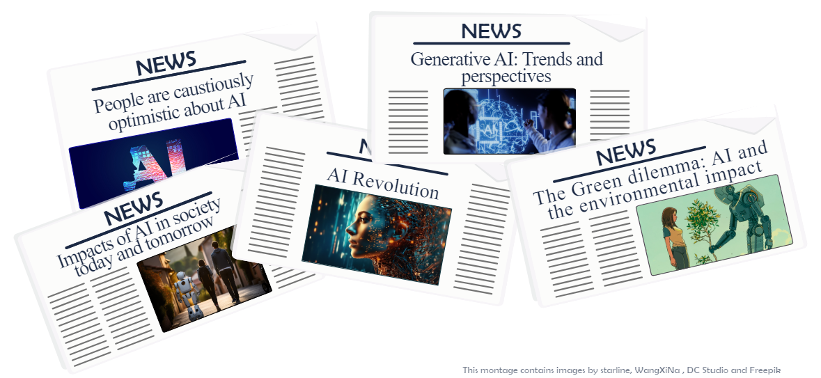

Artificial Intelligence everywhere
This montage contains adaptations of real headlines and images from several authors on freepik
Term coined 1955 (stanford university)
Intelligent computer idea since 1990’s
Big “boooom” 2020’s
Notes:
_____________ Icons Attribution and link _________________
This montage contains adaptations of real headlines and images from freepik (People hanging out with robot, Cartoon AI, and Portrait of person with robot), from Starline (AI concept design), from WangXiNa (Human Big data), and from DC studios (Engineers brainstorm AI).
Circular image with people working: Image generate by AI (copilot - GPT4) and adapted with company colors.
_____________ Slides notes _________________
Nowadays AI is everywhere over the news, suddenly something that was a total mystery has become commonplace. Now everyone has, at the very minimum, heard about it and probably share some opinion on it.
Despite of not being new, with the term being coined in 1955 and the whole idea of an intelligent computer, with human-like capabilities of decision tree and problem solving has been on the rise. But it was recently, in the 2020’s when it had it’s was greatly dinfused. Now everyone is a bit closer to this technology.
But before I move forward and tell you more, let’s answer a questionnaire together, completely anonymous.

Slide 3

So, how do you feel about AI?
Mentimeter, let’s go
https://www.mentimeter.com/app/presentation/n/aleh4qrubhohuvefsh6evp9ymbkwwx2d/present?question=wjz3433nigny
Notes:
_____________ Icons Attribution and link _________________
Circular image with people working: Image generate by AI (copilot - GPT4) and adapted with company colors.
_____________ Slides notes _________________

Slide 4
Where do you see AI in your life?
Notes:
_____________ Icons Attribution and link _________________
Circular image with people working: Image generate by AI (copilot - GPT4) and adapted with company colors.
_____________ Slides notes _________________
Use this moment to let them talk in their lives where they think they are already using AI.
Some answers will be repeated in the next slides, but maybe you are surprised that people don’t realize how often they are in contact with it.
Then you can use the next slides to build upon their comments.

Slide 5

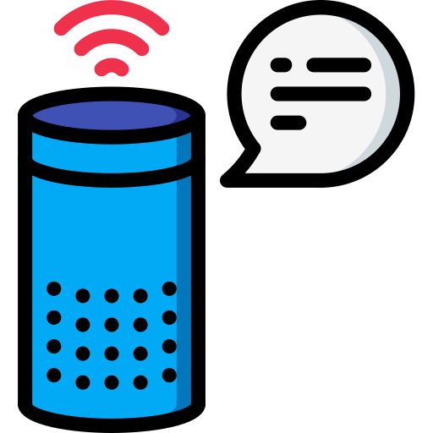



Where do you see AI in your life!
cellphones
assistants
chatbots
Online shopping
web search
Notes:
_____________ Slides notes _________________
The AI is already surrounding our lives for while, without even realizing it was already there.
In our phones we can find it in the face and fingerprint recognition, text completion as much as connected to various apps and other functionalities. For example the smart assistant like siri.
Very similarly you have now the assistantes like Alexa and Google Nest, that you can talk to, ask to make your grocery list, count the time, play music or just tell you a joke.
These are the most advanced version of the chatbots, probably you have interacted with them when trying to figure something while online shopping.
That is another good example, online shopping optimizing, advertisements improvement and personalization are also making use of artificial intelligence.
You probably realized the mostly good suggestions to complete your search request in the browser, but also that the more you research the better are your results. Therefor not always your results are the same as the ones for your friends. Because the searching tools is learning your preferences and kind of interests you have and tries to give you optimized results.
_____________ Icons Attribution and link _________________
Smart assistante By @Smashicons https://www.freepik.com/icon/echo-dot_1599470#fromView=search&page=1&position=34&uuid=a71f5479-2fb1-46d4-b92c-70fe7413281a
Celphone By @freepik https://www.freepik.com/icon/iphone_644463#fromView=search&page=1&position=35&uuid=88766a27-f96d-4441-a29f-d4c0111cbef7
Chatbot By @Flat Icons https://www.freepik.com/icon/chatbot_3271142#fromView=search&page=1&position=30&uuid=00e06c97-369a-4979-a8e5-75e4340186e6
Car By @edt.im https://www.freepik.com/icon/vehicle_14154221#fromView=search&page=1&position=61&uuid=def279b7-00aa-4459-867d-fb11776bd93c
Web search By @rsetiawan https://www.freepik.com/icon/search_4797787#fromView=search&page=1&position=0&uuid=a0b7568f-9d81-4f87-956a-d5c2573c77b7

Slide 6


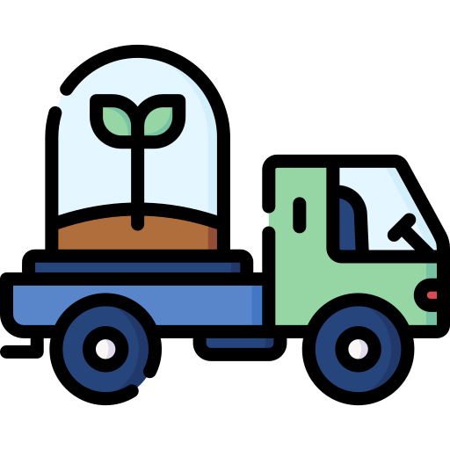
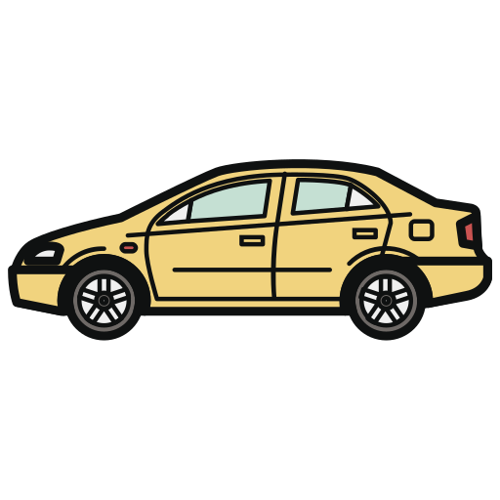
Where do you see AI in your life!
cellphones
assistants
chatbots
Online shopping
web search
smart home
autonomous car
cyber security
smart farming
Notes:
_____________ Slides notes _________________
As this grows we can see the smart houses, autonomous cars, smart farming taking care of irrigation, feeding, etc. The robots are present in the factories supporting the production, and sometimes in research optimizing DNA extraction and synthesis. Not to forget cyber security. So we are surrounded by AI for a while already, and now with the generative AI taking a commonplace closer to everyone’s lives, it will become even more evident.
_____________ Icons Attribution and link _________________
Truck By @freepik https://www.freepik.com/icon/delivery-truck_3142390#fromView=search&page=1&position=19&uuid=bce83080-e0ee-43df-933b-581ebf82dd07
Cyber securityBy @zero_wing https://www.freepik.com/icon/cyber-security_9767131#fromView=search&page=2&position=52&uuid=a0b7568f-9d81-4f87-956a-d5c2573c77b7
Smart home By @mikan933 https://www.freepik.com/icon/smart-home_3895359
Online shopping By @Vectorslab https://www.freepik.com/icon/online-payment_16991519?log-in=google#fromView=search&page=1&position=4&uuid=f655111a-a04a-4803-8830-d87a787c3e7a
Smart assistante By @Smashicons https://www.freepik.com/icon/echo-dot_1599470#fromView=search&page=1&position=34&uuid=a71f5479-2fb1-46d4-b92c-70fe7413281a
Celphone By @freepik https://www.freepik.com/icon/iphone_644463#fromView=search&page=1&position=35&uuid=88766a27-f96d-4441-a29f-d4c0111cbef7
Chatbot By @Flat Icons https://www.freepik.com/icon/chatbot_3271142#fromView=search&page=1&position=30&uuid=00e06c97-369a-4979-a8e5-75e4340186e6
Car By @edt.im https://www.freepik.com/icon/vehicle_14154221#fromView=search&page=1&position=61&uuid=def279b7-00aa-4459-867d-fb11776bd93c
Web search By @rsetiawan https://www.freepik.com/icon/search_4797787#fromView=search&page=1&position=0&uuid=a0b7568f-9d81-4f87-956a-d5c2573c77b7

Slide 7
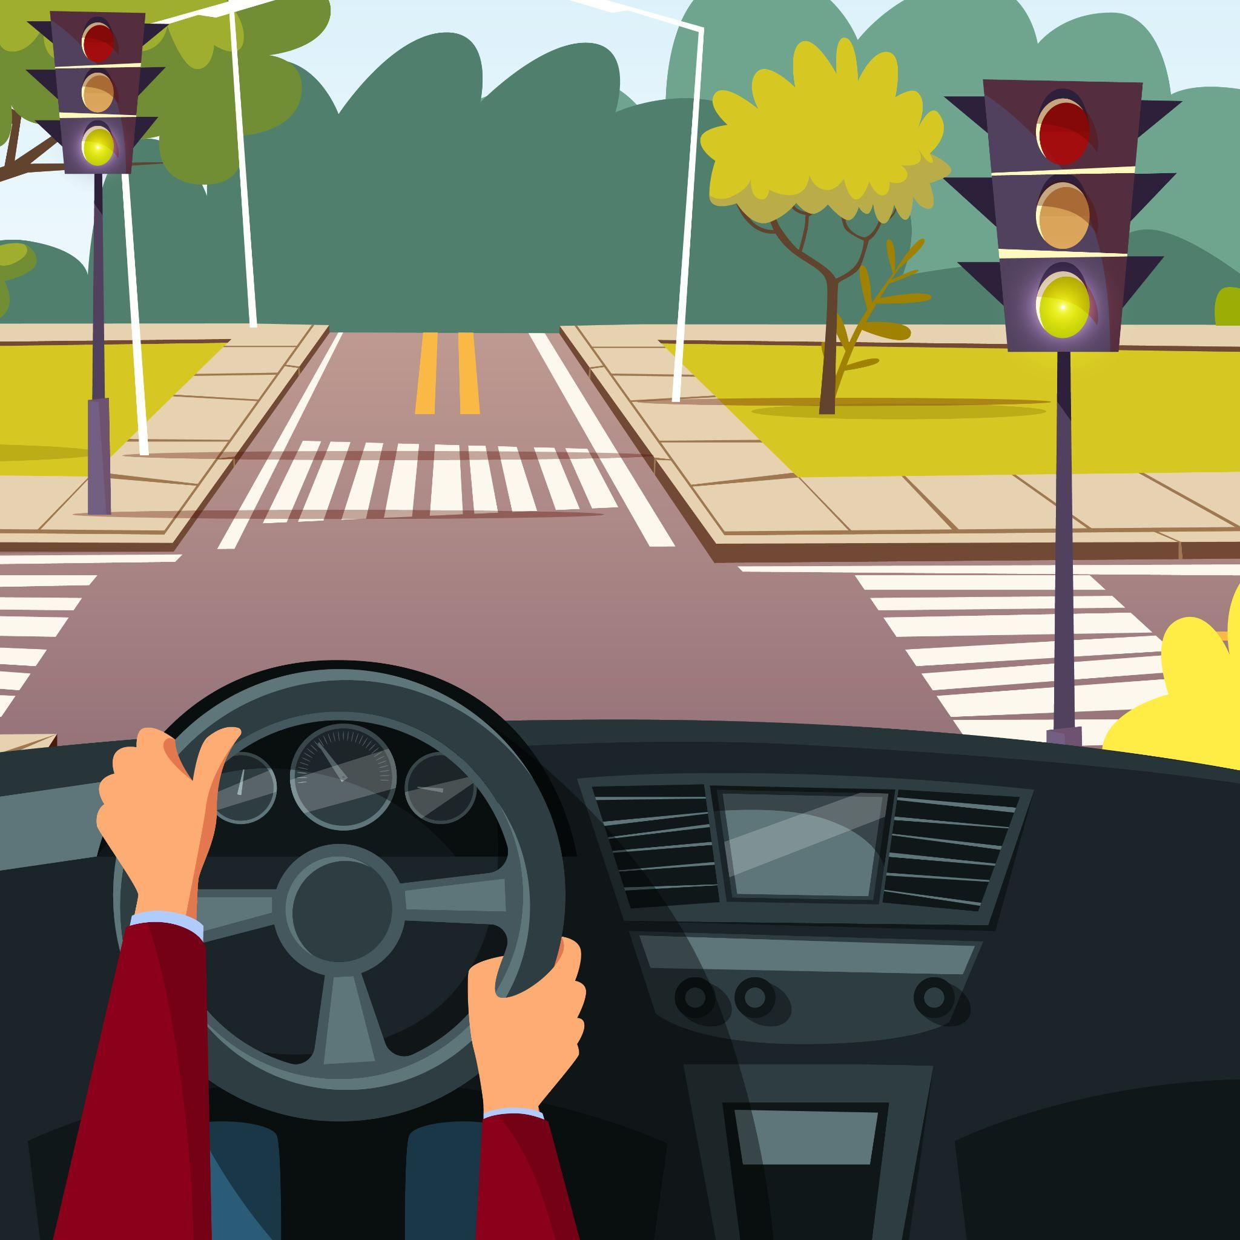
We’ll teach you how to drive
Not how to build a car
@vectorpouchon freepik
Notes:
_____________ Attribution and link _________________
Cartoon man hands on car by @vectorpouchon on freepik: https://www.freepik.com/free-vector/cartoon-man-hands-car-wheel-driving-vehicle-street-crossroad-background_2238481.htm?log-in=email#fromView=search&page=1&position=8&uuid=134ace34-e491-4932-98c1-966d5d93e4a6
Slide adapted from James Boyko, “An introduction to Generative AI tools for Research (version 2)” - University of Michigan - https://docs.google.com/presentation/d/19Fe8BNQA4KZLSDCsZ8ffYqmtKtaFpcid4OdwQGqMKe8/edit#slide=id.g268fa1d774c_0_57
(reuse was authorized by mail exchange - 2024)
_____________ Slides notes _________________
But don’t worry, all this information is to give you some background. But we only intend to teach you how to drive, not how to build the car.
I just want to give you some background, so just a few more background information before we move on to something more practical

Slide 8

What is behind AI ?
Statistics based
Patterns
Notes:
_____________ Icons Attribution and link _________________
Data processing concept illustration by @storyset on freepik: https://www.freepik.com/free-vector/data-processing-concept-illustration_11604317.htm#fromView=search&page=1&position=1&uuid=11bf2fc4-31d2-4b85-9d74-342cc80b7259
_____________ Slides notes _________________
What we call AI is a group of technologies based on statics and that has as its very base what we call Large Language Models (LLMs)

Slide 9
What is behind AI ?
Statistics based
Patterns
LLMs = Large language models
Predict the next word
@storyset on freepik
Notes:
_____________ Icons Attribution and link _________________
Data processing concept illustration by @storyset on freepik: https://www.freepik.com/free-vector/data-processing-concept-illustration_11604317.htm#fromView=search&page=1&position=1&uuid=11bf2fc4-31d2-4b85-9d74-342cc80b7259
_____________ Slides notes _________________
LLMs are trained to predict the next word like in this example

Slide 10
What is behind AI ?
Statistics based
Patterns
LLMs = Large language models
Predict the next word
@storyset on freepik
“ This was seasoned with pepper and __________ ”
Notes:
_____________ Icons Attribution and link _________________
Data processing concept illustration by @storyset on freepik: https://www.freepik.com/free-vector/data-processing-concept-illustration_11604317.htm#fromView=search&page=1&position=1&uuid=11bf2fc4-31d2-4b85-9d74-342cc80b7259
_____________ Slides notes _________________
How would you complete it?
Paprika? …. Curry? …… Cinnamon?
NO
You would with no doubt say “pepper and salt”
Just because it is the most probably answer, despite of other possibilities.
But imagine it has been trained in Large data sets (I’ll come back to it soon) but also with a large number of parameters.
That is why it is called Large Language model

Slide 11
What is behind AI ?
Statistics based
Patterns
Machine algorithm → Human-like
Problem solving
Complex data
Flexible analysis
Dynamic process
@storyset on freepik
Notes:
_____________ Icons Attribution and link _________________
Data processing concept illustration by @storyset on freepik: https://www.freepik.com/free-vector/data-processing-concept-illustration_11604317.htm#fromView=search&page=1&position=1&uuid=11bf2fc4-31d2-4b85-9d74-342cc80b7259
_____________ Slides notes _________________
The aim for AI is that this statical models could be able to perform Complex, Flexible, Dynamic tasks in a Human-like way.

Slide 12
What is behind AI ?
Statistics based
Patterns
Machine algorithm → Human-like
Problem solving
Complex data
Flexible analysis
Dynamic process
Decision making
@storyset on freepik
Notes:
_____________ Icons Attribution and link _________________
Data processing concept illustration by @storyset on freepik: https://www.freepik.com/free-vector/data-processing-concept-illustration_11604317.htm#fromView=search&page=1&position=1&uuid=11bf2fc4-31d2-4b85-9d74-342cc80b7259
_____________ Slides notes _________________
And ultimately help with decision making

Slide 13
What is behind AI ?
Statistics based
Patterns
Machine algorithm → Human-like
Problem solving
Complex data
Flexible analysis
Dynamic process
Decision making
Trained from datasets
Variable complexity and specificity
@storyset on freepik
Notes:
_____________ Icons Attribution and link _________________
Data processing concept illustration by @storyset on freepik: https://www.freepik.com/free-vector/data-processing-concept-illustration_11604317.htm#fromView=search&page=1&position=1&uuid=11bf2fc4-31d2-4b85-9d74-342cc80b7259
_____________ Slides notes _________________
To achieve different tasks and different challenges different models will be trained with datasets of variable complexity or specificity

Slide 14
AI, a set of technologies
A set of technologies:
AI
pattern recognition
ML (machine learning)
Large datasets
DL (Deep Learning)
Multilayered dataset
Large language models (LLM)
Generative AI
Generate content
Based in pattern recognition
able of learning from data
Notes:
_____________ Icons Attribution and link _________________
Image representing the subsets of technologies. The image was inspired by Zhuhadar and Lytras 2023, DOI:10.3390/su151813484
_____________ Slides notes _________________
As said before what we call AI is actually a set of technologies that aims for human-like capabilities such as learning, making decisions and problem solving.

Slide 15
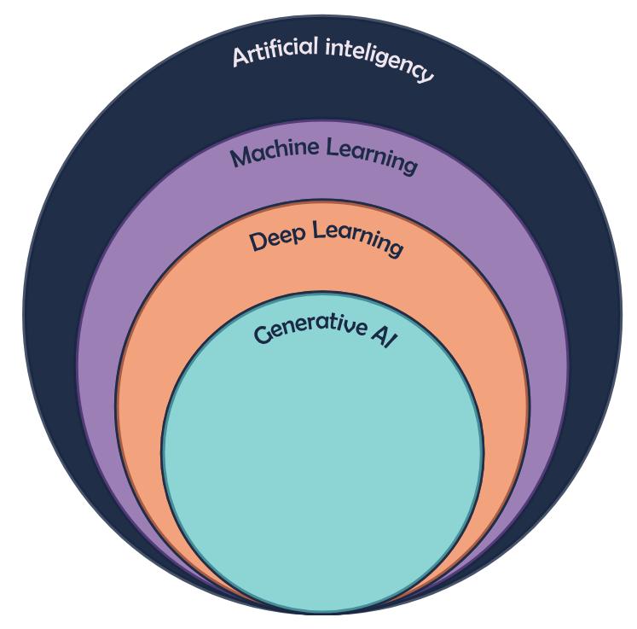
AI, a set of technologies
A set of technologies:
AI
pattern recognition
ML (machine learning)
Large datasets
DL (Deep Learning)
Multilayered dataset
Large language models (LLM)
Generative AI
Generate content
Based in pattern recognition
able of learning from data
Notes:
_____________ Icons Attribution and link _________________
Image representing the subsets of technologies. The image was inspired by Zhuhadar and Lytras 2023, DOI:10.3390/su151813484
_____________ Slides notes _________________
These features are based on pattern recognition, statiscal methods, that will increase in complexity based on the the size and complexity of the data. The data is used to learn patterns, |I’ll explain a bit more about it soon.

Slide 16
AI, a set of technologies
A set of technologies:
AI
pattern recognition
ML (machine learning)
Large datasets
DL (Deep Learning)
Multilayered dataset
Large language models (LLM)
Generative AI
Generate content
Based in pattern recognition
able of learning from data
Notes:
_____________ Icons Attribution and link _________________
Image representing the subsets of technologies. The image was inspired by Zhuhadar and Lytras 2023, DOI:10.3390/su151813484
_____________ Slides notes _________________
Trying to shortly explain each of them so you understand the increasing complexity and differences.
We can say ML is what we also call Classic AI, uses large datasets and can create “classificators” based on pattern recognition.
DL will use higher complexity analysis to find patterns in multilayered data (hierarchically organized).
GenAI will use DL to generate content based on patterns learned from the multilayered data.

Slide 17
AI, a set of technologies
A set of technologies:
AI
pattern recognition
ML (machine learning)
Large datasets
DL (Deep Learning)
Multilayered dataset
Large language models (LLM)
Generative AI
Generate content
Based in pattern recognition
able of learning from data
Notes:
_____________ Icons Attribution and link _________________
Image representing the subsets of technologies. The image was inspired by Zhuhadar and Lytras 2023, DOI:10.3390/su151813484
_____________ Slides notes _________________
Trying to shortly explain each of them so you understand the increasing complexity and differences.
We can say ML is what we also call Classic AI, uses large datasets and can create “classificators” based on pattern recognition.
DL will use higher complexity analysis to find patterns in multilayered data (hierarchically organized).
GenAI will use DL to generate content based on patterns learned from the multilayered data.

Slide 18
AI, a set of technologies
A set of technologies:
AI
pattern recognition
ML (machine learning)
Large datasets
DL (Deep Learning)
Multilayered dataset
Large language models (LLM)
Generative AI
Generate content
Based in pattern recognition
able of learning from data
Notes:
_____________ Icons Attribution and link _________________
Image representing the subsets of technologies. The image was inspired by Zhuhadar and Lytras 2023, DOI:10.3390/su151813484
_____________ Slides notes _________________
Trying to shortly explain each of them so you understand the increasing complexity and differences.
We can say ML is what we also call Classic AI, uses large datasets and can create “classificators” based on pattern recognition.
DL will use higher complexity analysis to find patterns in multilayered data (hierarchically organized).
GenAI will use DL to generate content based on patterns learned from the multilayered data.

Slide 19
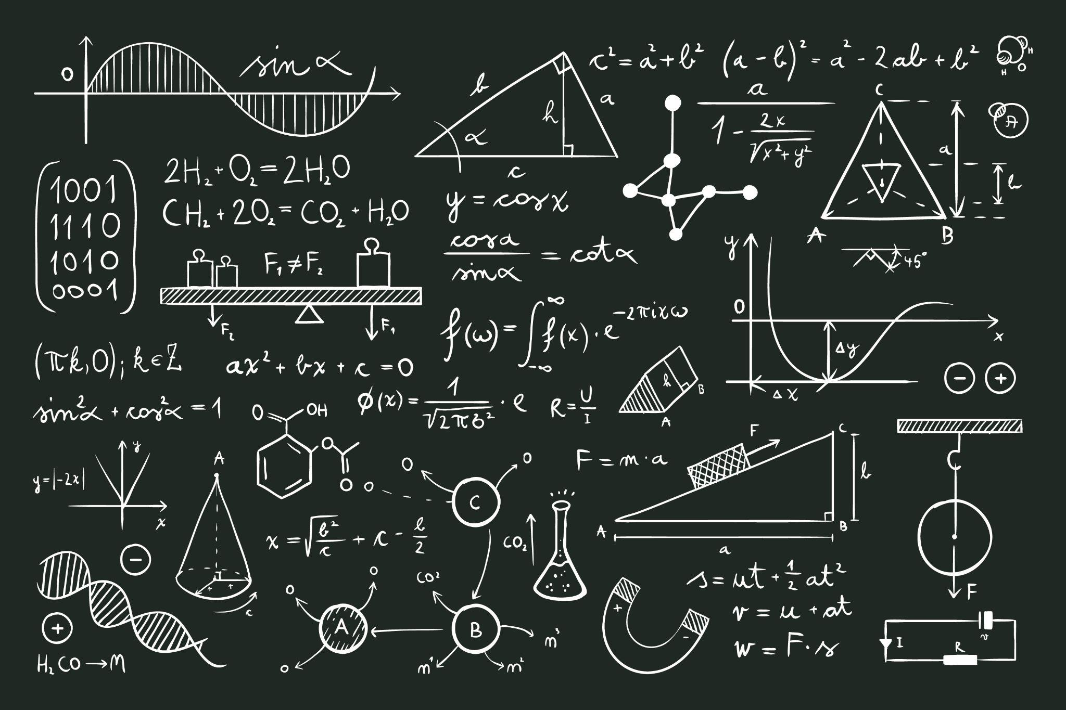
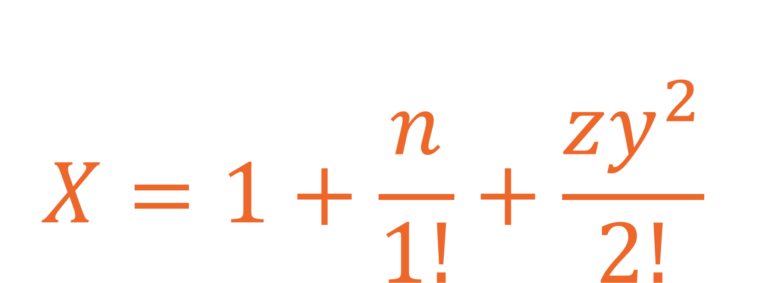
Concepts
information
Concepts
Data: Information
Algorithm: calculations
Create model
Optimize model
Model
Mathematical function
Enable predictions
by @freepik
Notes:
_____________ Icons Attribution and link _________________
Circular image with people working: Image generate by AI (copilot - GPT4) and adapted with company colors.
Hand drawn scientific formulas by @freepik: https://www.freepik.com/free-vector/hand-drawn-scientific-formulas-chalkboard_7762957.htm#fromView=search&page=1&position=47&uuid=f777d488-d32a-4669-b5e5-ff68c5357e63
_____________ Slides notes _________________
It is good that you understand these 3 concepts. Data is the information provided to the algorithm or to the model. The algorithm uses the data to classify, therefore learn from the data. The better the quality of the information, the better the results. And with this results the Model is created, the mathematical function that enable predictions based on what was learned from previous data. So the model will receive recent new data and be able to make predictions. Let me show it in an image, I believe it will be simples.

Slide 20
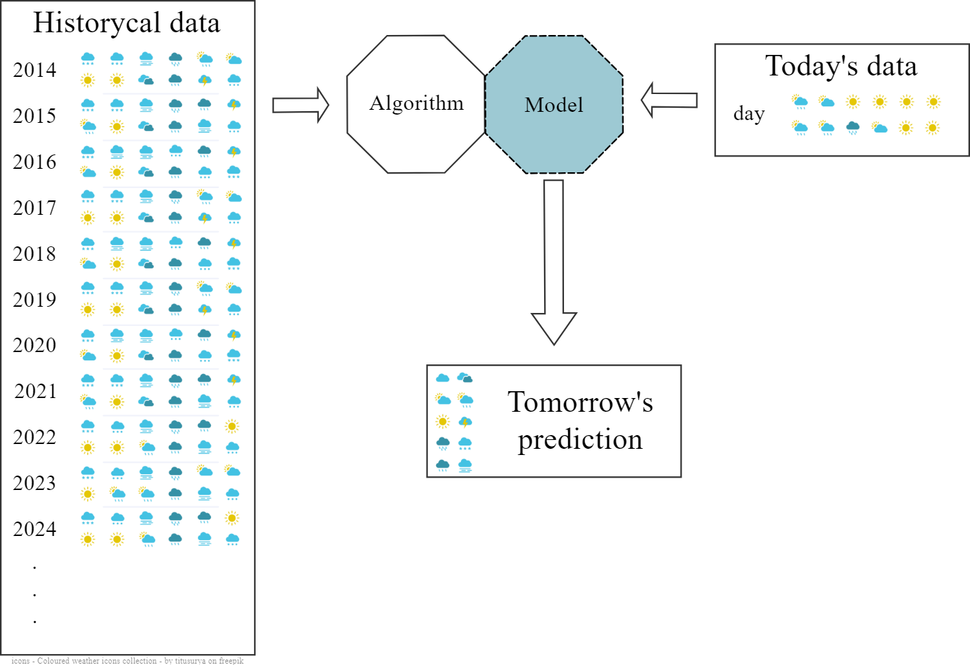

General example:
Notes:
_____________ Icons Attribution and link _________________
The icons in this image are available by @titusurya on Freepik: https://www.freepik.com/free-vector/coloured-weather-icons-collection_895655.htm#fromView=search&page=1&position=0&uuid=e7007644-b10b-428f-a96e-dea568c0f391
_____________ Slides notes _________________
The weather prediction is a great example and, specially in Belgium, we use it on a daily basis. The historical Algorithm learns from the historical data and based on that creates the best probabilistic model possible given the data it was fed. From that the model is created and can use this mathematical function to analyse today’s data to give the prediction for tomorrow or a few hours from now.
All that is to make very clear how the historical data, or whatever other data set is given to create the model, this is going to determine a lot of the output. The better the input, the better the output. But also, whatever biases are introduced, can be reproduced in the output.

Slide 21





Generative AI example:
prompt
real world data
Notes:
_____________ Icons Attribution and link _________________
The icons in this image are available by @titusurya on Freepik: https://www.freepik.com/free-vector/coloured-weather-icons-collection_895655.htm#fromView=search&page=1&position=0&uuid=e7007644-b10b-428f-a96e-dea568c0f391
World data by @Pixelmeetup on freepik: https://www.freepik.com/icon/big-data_12113636#fromView=search&page=1&position=19&uuid=bbad6519-b395-49b5-b207-e71dfdcfa9f9
Computer drawing @Vectorsclub on freepick: https://www.freepik.com/icon/graphic-design_15269549#fromView=search&page=1&position=20&uuid=71385200-e380-449d-b51a-f6f271193b9c
Video by @Prosymbols on freepik: https://www.freepik.com/icon/video-player_777242#fromView=search&page=1&position=41&uuid=cd6f6116-da21-4481-98e4-a88bc8ad503b
Text by @Freepik: https://www.freepik.com/icon/note_4021693#fromView=search&page=1&position=73&uuid=de9f74b0-6146-48a3-87dc-256209eb4f19
Code by @DinosoftLabs on Freepik: https://www.freepik.com/icon/coding_1802659#fromView=search&page=1&position=4&uuid=3e1449ea-6f22-4584-bbfd-f8bead98fcc6
Paint by @SBTS2018 on Freepik: https://www.freepik.com/icon/picture_15248137#fromView=search&page=4&position=23&uuid=9f4fd991-716a-4a5f-a0dd-3a8087cc957c
Man reading by @Vectorarte on Freepik, colors changed and text removed: https://www.freepik.com/free-vector/man-reading-background_1087087.htm#fromView=search&page=1&position=24&uuid=c53efe1d-e264-4bc0-8f84-1c2e67d96dcd
_____________ Slides notes _________________
In the Case of Generative AI, it uses real world data instead of curated and limited datasets and takes as input the queries that we do, what we call prompting. And instead of returning something like the weather prediction based on pattern recognition, it will have as output a text, code, video, drawing, etc, therefore we can say that genAI is great at pattern creation not only recognition
But that includes the worlds biases, as we are going to talk more soon.

Slide 22




GenAI products (examples)
Copilot (Microsoft)
ChatGPT (OpenAI)
Dalle-4 (OpenAI)
Gemini
Elicit
etc …
Copilot
Notes:
_____________ Icons Attribution and link _________________
Circular image with people working: Image generate by AI (copilot - GPT4) and adapted with company colors.
OpenAI logo on their brand guidelines: https://openai.com/brand/
Gemini logo: https://en.m.wikipedia.org/wiki/File:Google_Gemini_logo.svg
ELICITE logo : https://elicit.com/#FAQ
Copilot logo: https://en.m.wikipedia.org/wiki/File:Microsoft_365_Copilot_Icon.svg
_____________ Slides notes _________________
It is good that you understand these 3 concepts. Data is the information provided to the algorithm or to the model. The algorithm uses the data to classify, therefore learn from the data. The better the quality of the information, the better the results. And with this results the Model is created, the mathematical function that enable predictions based on what was learned from previous data. So the model will receive recent new data and be able to make predictions. Let me show it in an image, I believe it will be simples.

Slide 23
GenAI products (examples)
Model vs Product
Copilot (Microsoft)
ChatGPT (OpenAI)
Dalle-4 (OpenAI)
Gemini
Elicit
etc …
Notes:
_____________ Icons Attribution and link _________________
Businesswoman working by @iwat1929 on Freepik, she’s adapted to smile in this image: https://www.freepik.com/free-vector/illustration-sad-businesswoman-working-remotely_13923473.htm#fromView=search&page=2&position=43&uuid=934af582-459d-4d0a-8acd-038364a54f39
Businesswoman and businessmen working by @iwat1929 on Freepik: https://www.freepik.com/free-vector/illustration-businesswoman-businessmen-working-remotely_13923480.htm#fromView=author&page=1&position=23&uuid=c7b7f9a5-050f-461d-9dd8-88321fc85281
_____________ Slides notes _________________
It is good that you understand these 3 concepts. Data is the information provided to the algorithm or to the model. The algorithm uses the data to classify, therefore learn from the data. The better the quality of the information, the better the results. And with this results the Model is created, the mathematical function that enable predictions based on what was learned from previous data. So the model will receive recent new data and be able to make predictions. Let me show it in an image, I believe it will be simples.

Slide 24
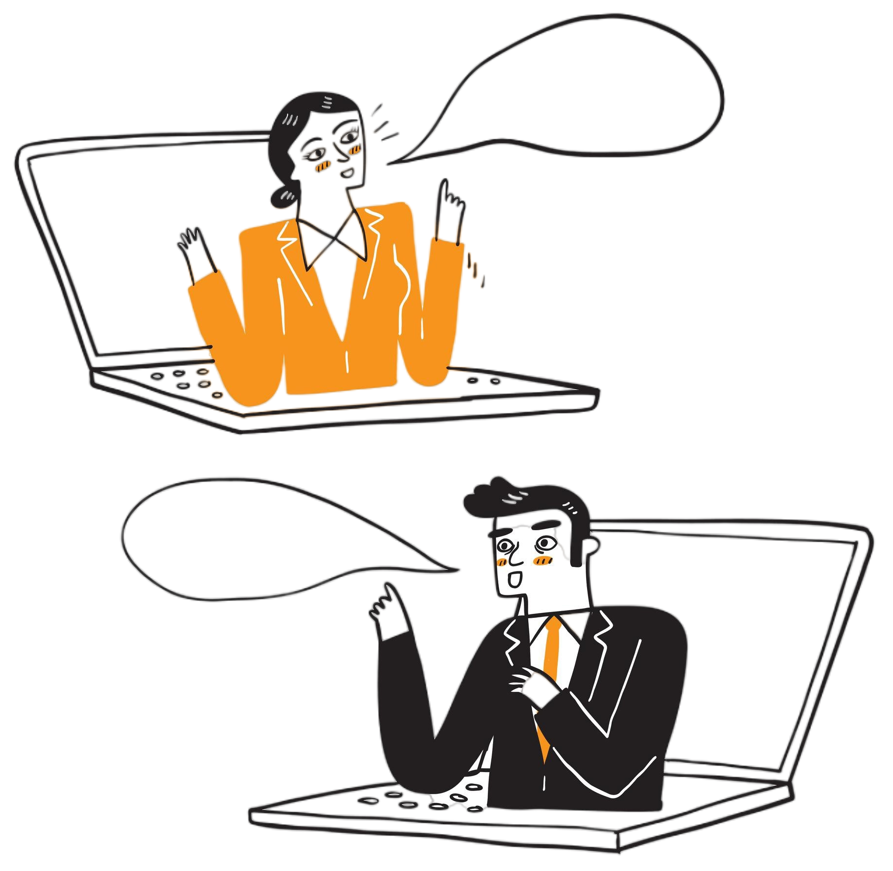
GenAI products (examples)
Model vs Product
Copilot (Microsoft)
ChatGPT (OpenAI)
Dalle-4 (OpenAI)
Gemini
Elicit
etc …
by @iwat1929 on Freepik
Friendly interfaces:
Intermediary
Own policies
Can keeps info
Notes:
_____________ Icons Attribution and link _________________
Businesswoman working by @iwat1929 on Freepik, she’s adapted to smile in this image: https://www.freepik.com/free-vector/illustration-sad-businesswoman-working-remotely_13923473.htm#fromView=search&page=2&position=43&uuid=934af582-459d-4d0a-8acd-038364a54f39
Businesswoman and businessmen working by @iwat1929 on Freepik: https://www.freepik.com/free-vector/illustration-businesswoman-businessmen-working-remotely_13923480.htm#fromView=author&page=1&position=23&uuid=c7b7f9a5-050f-461d-9dd8-88321fc85281
_____________ Slides notes _________________
It is good that you understand these 3 concepts. Data is the information provided to the algorithm or to the model. The algorithm uses the data to classify, therefore learn from the data. The better the quality of the information, the better the results. And with this results the Model is created, the mathematical function that enable predictions based on what was learned from previous data. So the model will receive recent new data and be able to make predictions. Let me show it in an image, I believe it will be simples.

Slide 25

GenAI products (examples)
Model vs Product
Copilot (Microsoft)
ChatGPT (OpenAI)
Dalle-4 (OpenAI)
Gemini
Elicit
etc …
by @iwat1929 on Freepik
by @iwat1929 on Freepik
Your set-up:
Locally
Remotely
API
Friendly interfaces:
Intermediary
Own policies
Can keeps info
Notes:
_____________ Icons Attribution and link _________________
Businesswoman working by @iwat1929 on Freepik, she’s adapted to smile in this image: https://www.freepik.com/free-vector/illustration-sad-businesswoman-working-remotely_13923473.htm#fromView=search&page=2&position=43&uuid=934af582-459d-4d0a-8acd-038364a54f39
Businesswoman and businessmen working by @iwat1929 on Freepik: https://www.freepik.com/free-vector/illustration-businesswoman-businessmen-working-remotely_13923480.htm#fromView=author&page=1&position=23&uuid=c7b7f9a5-050f-461d-9dd8-88321fc85281
_____________ Slides notes _________________
It is good that you understand these 3 concepts. Data is the information provided to the algorithm or to the model. The algorithm uses the data to classify, therefore learn from the data. The better the quality of the information, the better the results. And with this results the Model is created, the mathematical function that enable predictions based on what was learned from previous data. So the model will receive recent new data and be able to make predictions. Let me show it in an image, I believe it will be simples.

Slide 26
What you can do with GenAI tools
Ask general questions
Draft
Concepts
Paragraphs
Summaries
Etc …
Generate
Code
Image
Video
In Research
Writing and language improvement
Inspiration
Literature Search
Graphs making
Feedback simulation
Notes:
_____________ Icons Attribution and link _________________
Circular image with people working: Image generate by AI (copilot - GPT4) and adapted with company colors.
OpenAI logo on their brand guidelines: https://openai.com/brand/
Gemini logo: https://en.m.wikipedia.org/wiki/File:Google_Gemini_logo.svg
ELICITE logo : https://elicit.com/#FAQ
Copilot logo: https://en.m.wikipedia.org/wiki/File:Microsoft_365_Copilot_Icon.svg
_____________ Slides notes _________________
It is good that you understand these 3 concepts. Data is the information provided to the algorithm or to the model. The algorithm uses the data to classify, therefore learn from the data. The better the quality of the information, the better the results. And with this results the Model is created, the mathematical function that enable predictions based on what was learned from previous data. So the model will receive recent new data and be able to make predictions. Let me show it in an image, I believe it will be simples.

Slide 27
VIB AI-Policy

Slide 28
VIB wants:
1. To stimulate the responsible use of genAI
2. Awareness of the strengths and limitations of genAI
3. You to perform the necessary verification and quality control
4. You to refrain from using of genAI if:
risks to disclosure of confidential or personal information
See practical guideline on the responsible use of genAI tools: https://home.vib.be/#/knowledge-base/article/1322

Slide 29
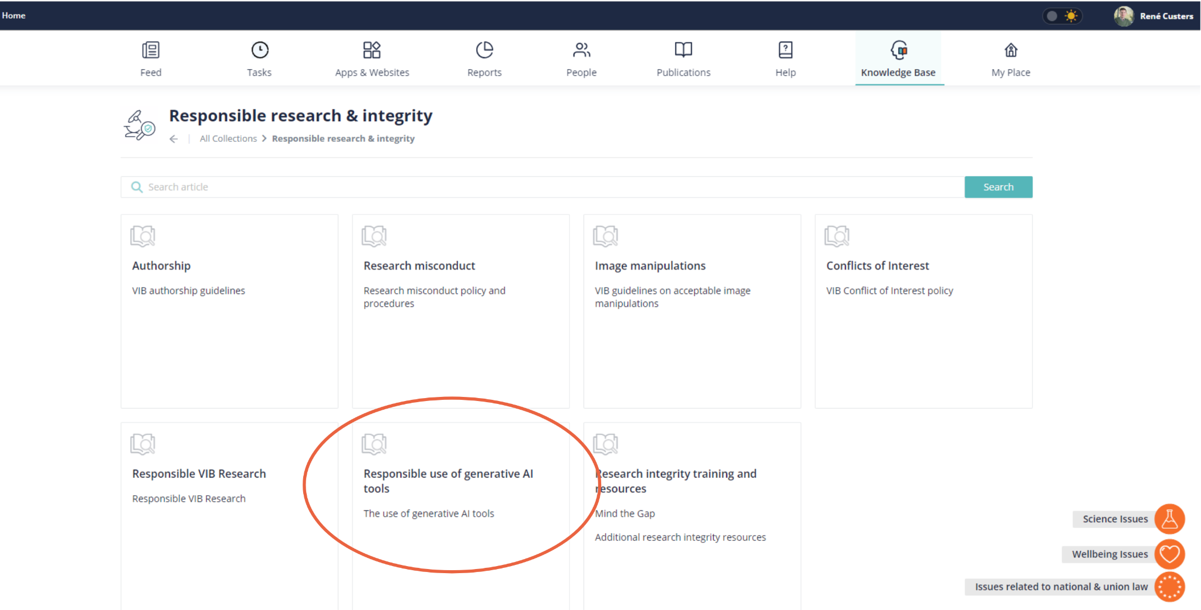
Discover the whole document on kb.vib.be
https://kb.vib.be/#/article/1322

Slide 30
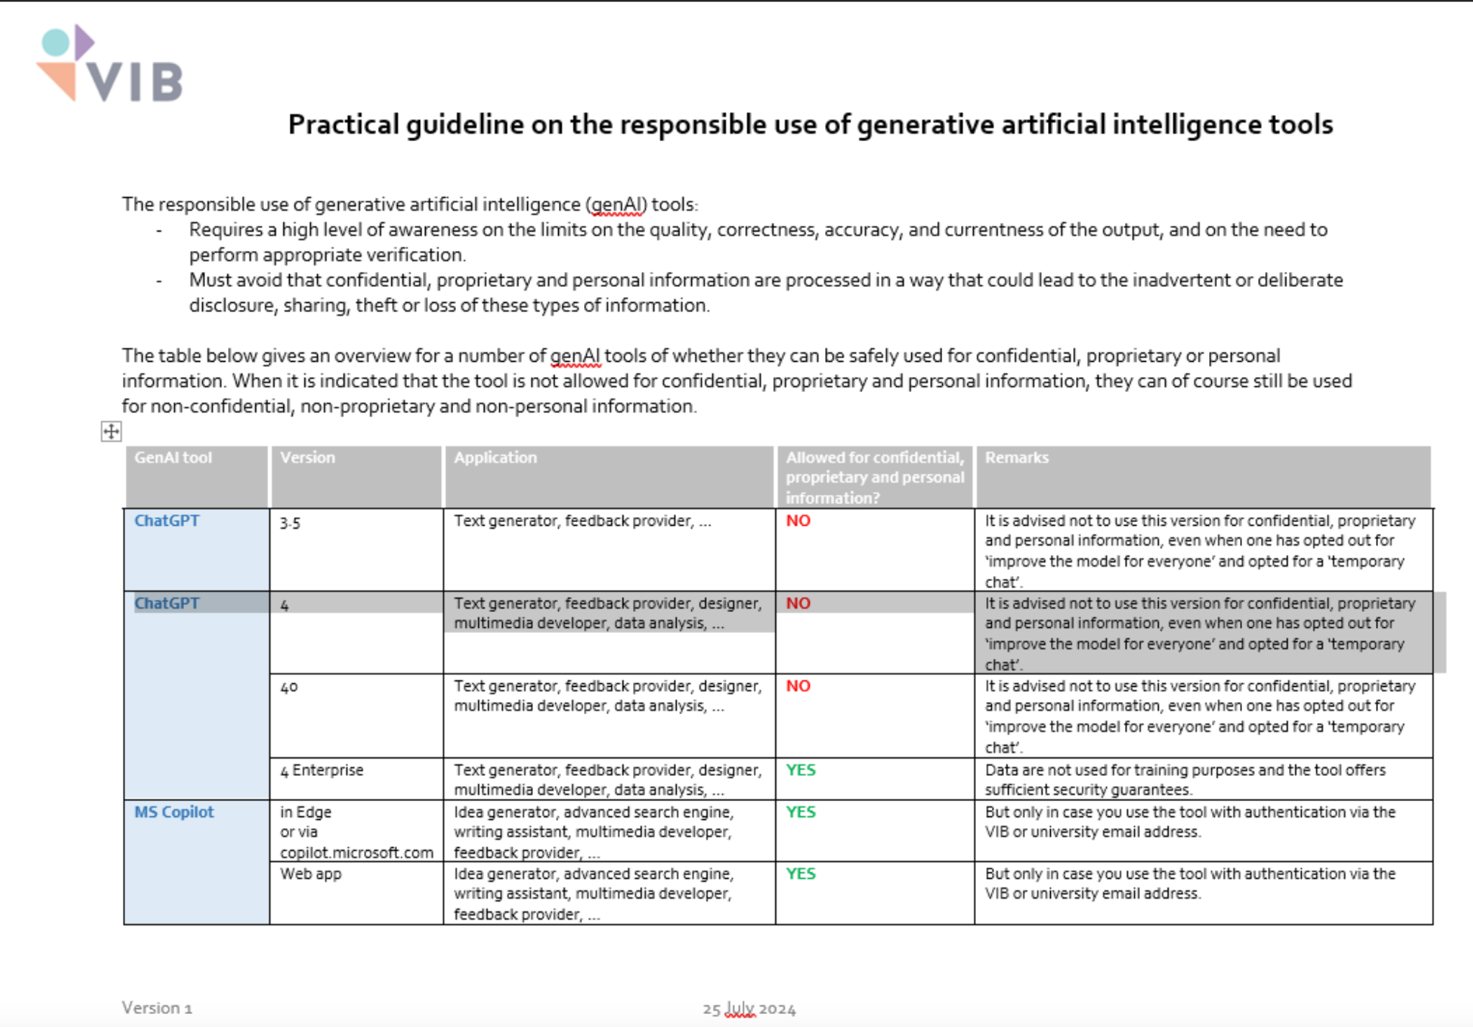
Some practical guidelines

Slide 31
Some practical guidelines
Overview of whether they can be SAFELY used for:
Confidential
Proprietary
Personal
YES

Slide 32
Some practical guidelines
Copilot
Overview of whether they can be SAFELY used for:
Confidential
Proprietary
Personal
They CAN STILL be used for:
- non-confidential
- non-proprietary
- non-personal
YES
NO

Slide 33
BEFORE YOU START USING IT
things to take in account

Slide 34
Privacy Policy & Copyrights
always look into it

Slide 35
Privacy policy
Data privacy
GenAI tools can:
Retain your information
Use it for (re)training (model improvement)
Make data collection of:
Device info.
Geolocation
IP address
Notes:
_____________ Icons Attribution and link _________________
Circular image with people working: Image generate by AI (copilot - GPT4) and adapted with company colors.
_____________ Slides notes _________________

Slide 36
Privacy policy
Data privacy
Don’t input
GenAI tools can:
Retain your information
Use it for (re)training (model improvement)
Make data collection of:
Device info.
Geolocation
IP address
Institutional information
Personal & Sensitive data
Risks
Disclose sensitive or personal data
Loss of confidentiality, copyrights, etc
Notes:
_____________ Icons Attribution and link _________________
Circular image with people working: Image generate by AI (copilot - GPT4) and adapted with company colors.
_____________ Slides notes _________________

Slide 37
Examples policies of free version:
Notes:
_____________ Icons Attribution and link _________________
Circular image with people working: Image generate by AI (copilot - GPT4) and adapted with company colors.
_____________ Slides notes _________________

Slide 38



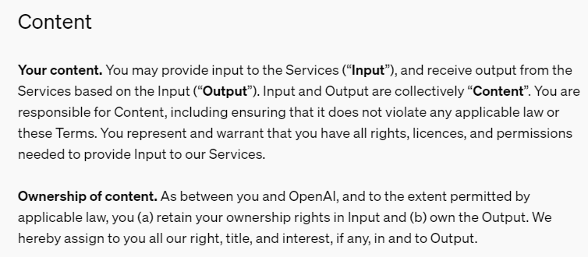
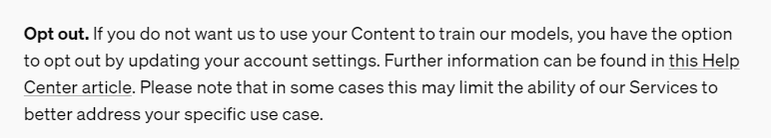
Examples policies of free version:
https://openai.com/policies/terms-of-use/
Notes:
_____________ Icons Attribution and link _________________
Circular image with people working: Image generate by AI (copilot - GPT4) and adapted with company colors.
_____________ Slides notes _________________

Slide 39

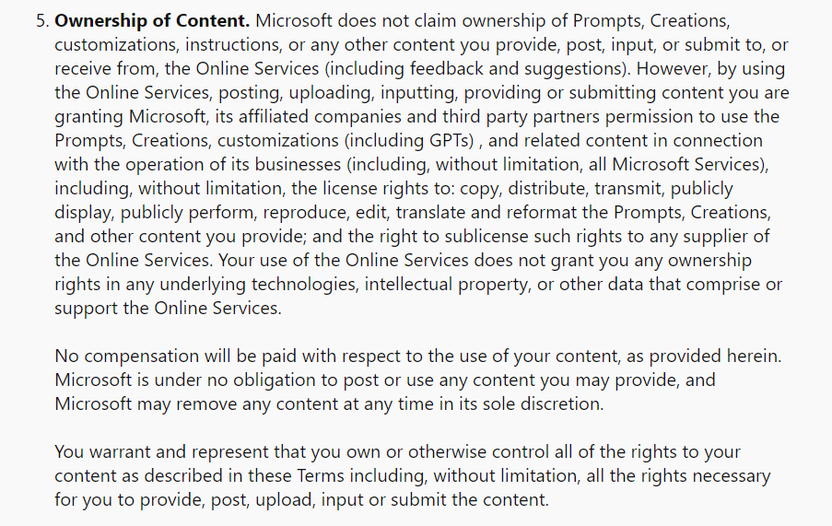
Examples policies of free version:
Copilot
Notes:
_____________ Icons Attribution and link _________________
Circular image with people working: Image generate by AI (copilot - GPT4) and adapted with company colors.
_____________ Slides notes _________________

Slide 40

Copyrights
What is “copyrightable” ?
?
works and creations that are original.
They must be the result of the author’s own intellectual work, and not a copy of a pre-existing work
?
by rawpixel.com on freepik
Notes:
_____________ Icons Attribution and link _________________
EU commission about AI copyrights - july 2024: https://intellectual-property-helpdesk.ec.europa.eu/news-events/news/artificial-intelligence-and-copyright-use-generative-ai-tools-develop-new-content-2024-07-16-0_en
Copyright stamp image by rawpixel in freepik: https://www.freepik.com/free-photo/copyright-design-license-patent-trademark-value-concept_17056553.htm#fromView=search&page=1&position=12&uuid=e00a7ccd-09a6-4b8a-b3be-debfa5071ec0
_____________ Slides notes _________________

Slide 41
Copyrights
What is “copyrightable” ?
?
works and creations that are original.
They must be the result of the author’s own intellectual work, and not a copy of a pre-existing work
?
Who owns the work?
The author or the institution
In general the author, however work produced in normal course of employment are owned by employer.
by rawpixel.com on freepik
Notes:
_____________ Icons Attribution and link _________________
EU commission about AI copyrights - july 2024: https://intellectual-property-helpdesk.ec.europa.eu/news-events/news/artificial-intelligence-and-copyright-use-generative-ai-tools-develop-new-content-2024-07-16-0_en
Copyright stamp image by rawpixel in freepik: https://www.freepik.com/free-photo/copyright-design-license-patent-trademark-value-concept_17056553.htm#fromView=search&page=1&position=12&uuid=e00a7ccd-09a6-4b8a-b3be-debfa5071ec0
_____________ Slides notes _________________

Slide 42
Copyrights
1 question = 2 challenges
?
?
by rawpixel.com on freepik
Notes:
_____________ Icons Attribution and link _________________
EU commission about AI copyrights - july 2024: https://intellectual-property-helpdesk.ec.europa.eu/news-events/news/artificial-intelligence-and-copyright-use-generative-ai-tools-develop-new-content-2024-07-16-0_en
Copyright stamp image by rawpixel in freepik: https://www.freepik.com/free-photo/copyright-design-license-patent-trademark-value-concept_17056553.htm#fromView=search&page=1&position=12&uuid=e00a7ccd-09a6-4b8a-b3be-debfa5071ec0
_____________ Slides notes _________________

Slide 43
1 question = 2 challenges
?
?
The potential copyright infringement by generative AI models
by rawpixel.com on freepik
Notes:
_____________ Icons Attribution and link _________________
EU commission about AI copyrights - july 2024: https://intellectual-property-helpdesk.ec.europa.eu/news-events/news/artificial-intelligence-and-copyright-use-generative-ai-tools-develop-new-content-2024-07-16-0_en
Copyright stamp image by rawpixel in freepik: https://www.freepik.com/free-photo/copyright-design-license-patent-trademark-value-concept_17056553.htm#fromView=search&page=1&position=12&uuid=e00a7ccd-09a6-4b8a-b3be-debfa5071ec0
_____________ Slides notes _________________

Slide 44
1 question = 2 challenges
?
?
The potential copyright infringement by generative AI models
Are works produced with generative AI tools copyrightable? By whom?
by rawpixel.com on freepik
Notes:
_____________ Icons Attribution and link _________________
EU commission about AI copyrights - july 2024: https://intellectual-property-helpdesk.ec.europa.eu/news-events/news/artificial-intelligence-and-copyright-use-generative-ai-tools-develop-new-content-2024-07-16-0_en
Copyright stamp image by rawpixel in freepik: https://www.freepik.com/free-photo/copyright-design-license-patent-trademark-value-concept_17056553.htm#fromView=search&page=1&position=12&uuid=e00a7ccd-09a6-4b8a-b3be-debfa5071ec0
_____________ Slides notes _________________

Slide 45
Is it copyrightable?
genAI can’t create “original” work
Ownership depends of:
Regulation (AI act in EU)
Extend of human and AI role
T&C of service provider
?
?
by rawpixel.com on freepik
Notes:
_____________ Icons Attribution and link _________________
EU commission about AI copyrights - july 2024: https://intellectual-property-helpdesk.ec.europa.eu/news-events/news/artificial-intelligence-and-copyright-use-generative-ai-tools-develop-new-content-2024-07-16-0_en
AI act european commission, first AI regulation: https://www.europarl.europa.eu/doceo/document/TA-9-2024-0138_EN.pdf
Short intro into AI act (6min read): https://www.europarl.europa.eu/topics/en/article/20230601STO93804/eu-ai-act-first-regulation-on-artificial-intelligence
Copyright stamp image by rawpixel in freepik: https://www.freepik.com/free-photo/copyright-design-license-patent-trademark-value-concept_17056553.htm#fromView=search&page=1&position=12&uuid=e00a7ccd-09a6-4b8a-b3be-debfa5071ec0
_____________ Slides notes _________________

Slide 46
Is it copyrightable?
genAI can’t create “original” work
Ownership depends of:
Regulation (AI act in EU)
Extend of human and AI role
T&C of service provider
Copyrights variations:
User of the tool (most cases)
Creator of the algorithm
No one
Is not entitled
Is considered to be in public domain
Under T&C of the service provider
?
?
by rawpixel.com on freepik
Notes:
_____________ Icons Attribution and link _________________
EU commission about AI copyrights - july 2024: https://intellectual-property-helpdesk.ec.europa.eu/news-events/news/artificial-intelligence-and-copyright-use-generative-ai-tools-develop-new-content-2024-07-16-0_en
AI act european commission, first AI regulation: https://www.europarl.europa.eu/doceo/document/TA-9-2024-0138_EN.pdf
Short intro into AI act (6min read): https://www.europarl.europa.eu/topics/en/article/20230601STO93804/eu-ai-act-first-regulation-on-artificial-intelligence
Copyright stamp image by rawpixel in freepik: https://www.freepik.com/free-photo/copyright-design-license-patent-trademark-value-concept_17056553.htm#fromView=search&page=1&position=12&uuid=e00a7ccd-09a6-4b8a-b3be-debfa5071ec0
_____________ Slides notes _________________

Slide 47
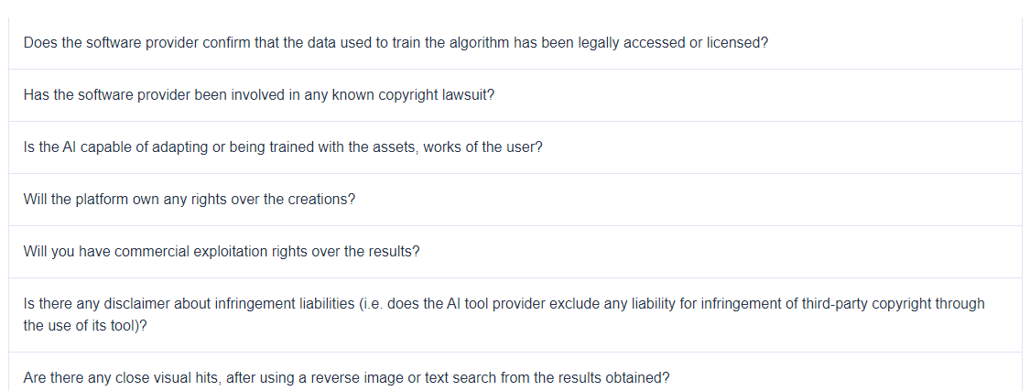
EU suggested checklist - about AI tools
?
?
Notes:
_____________ Icons Attribution and link _________________
EU commission about AI copyrights - july 2024: https://intellectual-property-helpdesk.ec.europa.eu/news-events/news/artificial-intelligence-and-copyright-use-generative-ai-tools-develop-new-content-2024-07-16-0_en
AI act european commission, first AI regulation: https://www.europarl.europa.eu/doceo/document/TA-9-2024-0138_EN.pdf
Short intro into AI act (6 min read): https://www.europarl.europa.eu/topics/en/article/20230601STO93804/eu-ai-act-first-regulation-on-artificial-intelligence
Copyright stamp image by rawpixel in freepik: https://www.freepik.com/free-photo/copyright-design-license-patent-trademark-value-concept_17056553.htm#fromView=search&page=1&position=12&uuid=e00a7ccd-09a6-4b8a-b3be-debfa5071ec0
_____________ Slides notes _________________

Slide 48
Hallucinations
don’t believe all you see
Notes:
_____________ Icons Attribution and link _________________
Circular image with people working: Image generate by AI (copilot - GPT4) and adapted with company colors.
OpenAI logo on their brand guidelines: https://openai.com/brand/
Gemini logo: https://en.m.wikipedia.org/wiki/File:Google_Gemini_logo.svg
ELICITE logo : https://elicit.com/#FAQ
Copilot logo: https://en.m.wikipedia.org/wiki/File:Microsoft_365_Copilot_Icon.svg
_____________ Slides notes _________________
It is good that you understand these 3 concepts. Data is the information provided to the algorithm or to the model. The algorithm uses the data to classify, therefore learn from the data. The better the quality of the information, the better the results. And with this results the Model is created, the mathematical function that enable predictions based on what was learned from previous data. So the model will receive recent new data and be able to make predictions. Let me show it in an image, I believe it will be simples.

Slide 49

GenAI Hallucinations
= Mistakes in GenAI
by @freepik
Notes:
_____________ Icons Attribution and link _________________
Girls by @freepik: https://www.freepik.com/free-vector/mental-health-awareness-concept_8398928.htm#fromView=search&page=2&position=3&uuid=0fca9aab-38cc-4481-bcb7-46022efebcaf
_____________ Slides notes _________________

Slide 50
GenAI Hallucinations
= Mistakes in GenAI
Syntax and Semantics
Are good!
Information
Incorrect
Fake
by @freepik
Notes:
_____________ Icons Attribution and link _________________
Girls by @freepik: https://www.freepik.com/free-vector/mental-health-awareness-concept_8398928.htm#fromView=search&page=2&position=3&uuid=0fca9aab-38cc-4481-bcb7-46022efebcaf
_____________ Slides notes _________________

Slide 51
GenAI Hallucinations
= Mistakes in GenAI
Syntax and Semantics
Are good!
Information
Incorrect
Fake
Wrong or made-up
Authors
Historical facts
References
URLs
by @freepik
Notes:
_____________ Icons Attribution and link _________________
Girls by @freepik: https://www.freepik.com/free-vector/mental-health-awareness-concept_8398928.htm#fromView=search&page=2&position=3&uuid=0fca9aab-38cc-4481-bcb7-46022efebcaf
_____________ Slides notes _________________

Slide 52

GenAI Hallucinations
= Mistakes in GenAI
Syntax and Semantics
Are good!
Information
Incorrect
Fake
example:
Asked for proof that dinosaurs built a civilization. ChatGPT stated:
"some species of dinosaurs even developed primitive forms of art, such as engravings on stones".
- Daniel E. Szempruch March 2023-
by @freepik
Notes:
_____________ Icons and examples Attribution and link _________________
Girls by @freepik: https://www.freepik.com/free-vector/mental-health-awareness-concept_8398928.htm#fromView=search&page=2&position=3&uuid=0fca9aab-38cc-4481-bcb7-46022efebcaf
Smart dino by @brgfx on feepik: https://www.freepik.com/free-vector/tyrannosaurus-rex-dinosaur-reading-newspaper-cartoon-style_23723071.htm#fromView=search&page=1&position=20&uuid=0650fb24-f6e2-4b4c-9c55-b90a62a32cde
Dino hallucination by Daniel E. Szempruch March 2023 on linkedin shared article “Generative AI Model Hallucinations: The Good, The Bad, and The Hilarious” : https://www.linkedin.com/pulse/generative-ai-model-hallucinations-good-bad-hilarious-szempruch/
_____________ Slides notes _________________

Slide 53
GenAI Hallucinations
= Mistakes in GenAI
Syntax and Semantics
Are good!
Information
Incorrect
Fake
example:
Asked for journalistic articles about invisibles workers in AI industry with links to the access the article:
Sure! Here are the links to the articles I mentioned:
“The Hidden Workforce Behind AI: The Human Cost of Training Algorithms” by The Guardian, 2023. Link
by @freepik
Notes:
_____________ Icons and examples Attribution and link _________________
Girls by @freepik: https://www.freepik.com/free-vector/mental-health-awareness-concept_8398928.htm#fromView=search&page=2&position=3&uuid=0fca9aab-38cc-4481-bcb7-46022efebcaf
Smart dino by @brgfx on feepik: https://www.freepik.com/free-vector/tyrannosaurus-rex-dinosaur-reading-newspaper-cartoon-style_23723071.htm#fromView=search&page=1&position=20&uuid=0650fb24-f6e2-4b4c-9c55-b90a62a32cde
Dino hallucination by Daniel E. Szempruch March 2023 on linkedin shared article “Generative AI Model Hallucinations: The Good, The Bad, and The Hilarious” : https://www.linkedin.com/pulse/generative-ai-model-hallucinations-good-bad-hilarious-szempruch/
_____________ Slides notes _________________

Slide 54
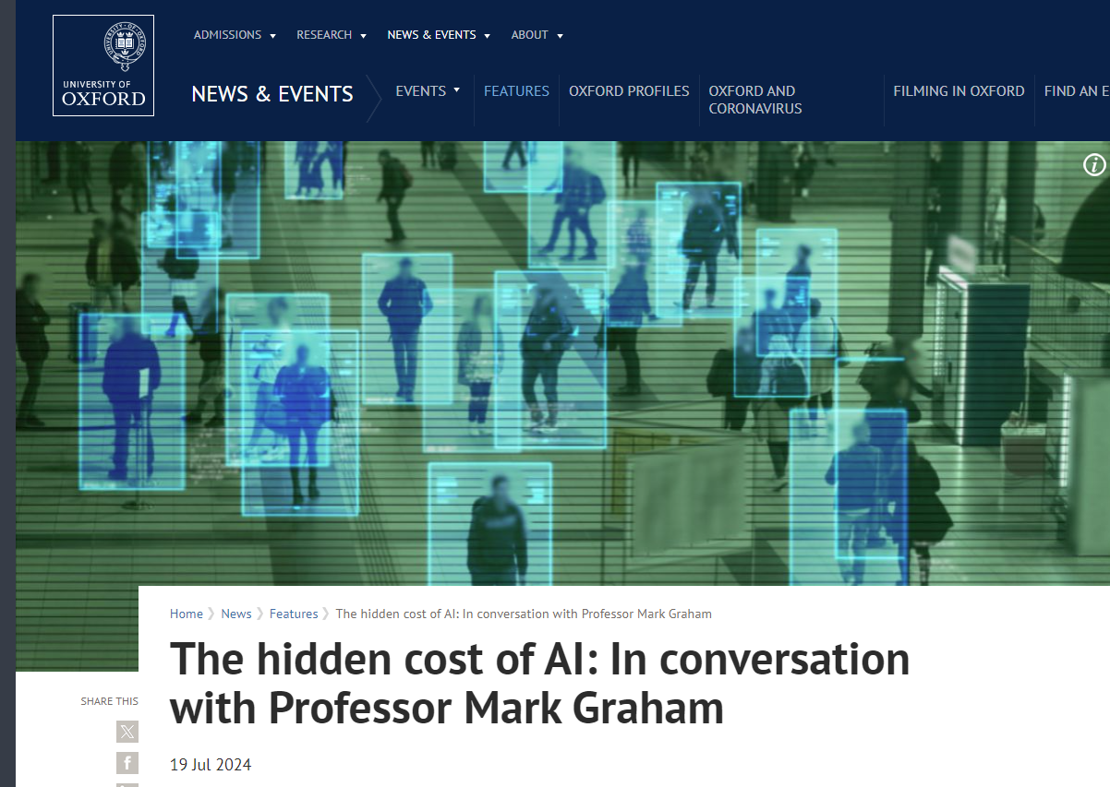
GenAI Hallucinations
Syntax and Semantics
Are good!
Information
Incorrect
Fake
example:
Asked for journalistic articles about invisibles workers in AI industry with links to the access the article:
Sure! Here are the links to the articles I mentioned:
“The Hidden Workforce Behind AI: The Human Cost of Training Algorithms” by The Guardian, 2023. Link
Notes:
_____________ Icons and examples Attribution and link _________________
Girls by @freepik: https://www.freepik.com/free-vector/mental-health-awareness-concept_8398928.htm#fromView=search&page=2&position=3&uuid=0fca9aab-38cc-4481-bcb7-46022efebcaf
Smart dino by @brgfx on feepik: https://www.freepik.com/free-vector/tyrannosaurus-rex-dinosaur-reading-newspaper-cartoon-style_23723071.htm#fromView=search&page=1&position=20&uuid=0650fb24-f6e2-4b4c-9c55-b90a62a32cde
Dino hallucination by Daniel E. Szempruch March 2023 on linkedin shared article “Generative AI Model Hallucinations: The Good, The Bad, and The Hilarious” : https://www.linkedin.com/pulse/generative-ai-model-hallucinations-good-bad-hilarious-szempruch/
_____________ Slides notes _________________

Slide 55
GenAI Hallucinations
= Mistakes in GenAI
Syntax and Semantics
Are good!
Information
Incorrect
Fake
Causes:
Outdated or low-quality data
Incorrect data-label
Inconsistencies in training data
Insufficient algorithm
Struggle with:
Colloquialism
Slang
Sarcasm
by @freepik
Notes:
_____________ Icons Attribution and link _________________
Girls by @freepik: https://www.freepik.com/free-vector/mental-health-awareness-concept_8398928.htm#fromView=search&page=2&position=3&uuid=0fca9aab-38cc-4481-bcb7-46022efebcaf
_____________ Slides notes _________________

Slide 56
GenAI Hallucinations
= Mistakes in GenAI
Can range from 4.9 to 27%
Syntax and Semantics
Are good!
Information
Incorrect
Fake
Causes:
Outdated or low-quality data
Incorrect data-label
Inconsistencies in training data
Insufficient algorithm
Struggle with:
Colloquialism
Slang
Sarcasm
by @freepik
Notes:
_____________ Icons Attribution and link _________________
Girls by @freepik: https://www.freepik.com/free-vector/mental-health-awareness-concept_8398928.htm#fromView=search&page=2&position=3&uuid=0fca9aab-38cc-4481-bcb7-46022efebcaf
_____________ Slides notes _________________

Slide 57
Biases in genAI
be mindful
Notes:
_____________ Icons Attribution and link _________________
Circular image with people working: Image generate by AI (copilot - GPT4) and adapted with company colors.
_____________ Slides notes _________________
It is good that you understand these 3 concepts. Data is the information provided to the algorithm or to the model. The algorithm uses the data to classify, therefore learn from the data. The better the quality of the information, the better the results. And with this results the Model is created, the mathematical function that enable predictions based on what was learned from previous data. So the model will receive recent new data and be able to make predictions. Let me show it in an image, I believe it will be simples.

Slide 58

Biases
Embedded in society
Reproduces societal challenges
Examples:
Ageism
Sexism
Racial
Classism
Conservatism
Urbanism
Stereotypical
by @freepik
Notes:
_____________ Icons Attribution and link _________________
Society by Freepik: https://www.freepik.com/free-vector/people-background-design_1358453.htm#fromView=search&page=1&position=0&uuid=b981178a-f35f-4023-a54a-dcbe3b692c51
genAI images generator biases: https://www.tandfonline.com/doi/full/10.1080/21670811.2023.2229883
_____________ Slides notes _________________

Slide 59
Biases
Let’s try one example:
Ask AI to generate an image of:
Politician
Company manager
Doctor
Primary school teacher, secretary
by @freepik
Notes:
_____________ Icons Attribution and link _________________
Society by Freepik: https://www.freepik.com/free-vector/people-background-design_1358453.htm#fromView=search&page=1&position=0&uuid=b981178a-f35f-4023-a54a-dcbe3b692c51
genAI images generator biases: https://www.tandfonline.com/doi/full/10.1080/21670811.2023.2229883
_____________ Slides notes _________________

Slide 60
Biases
I asked: To draw politician

Slide 61
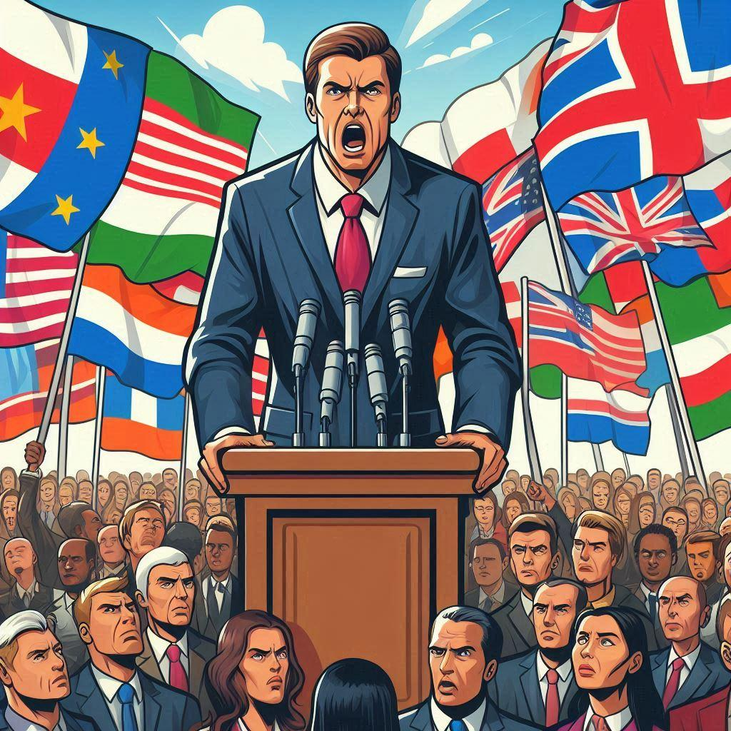
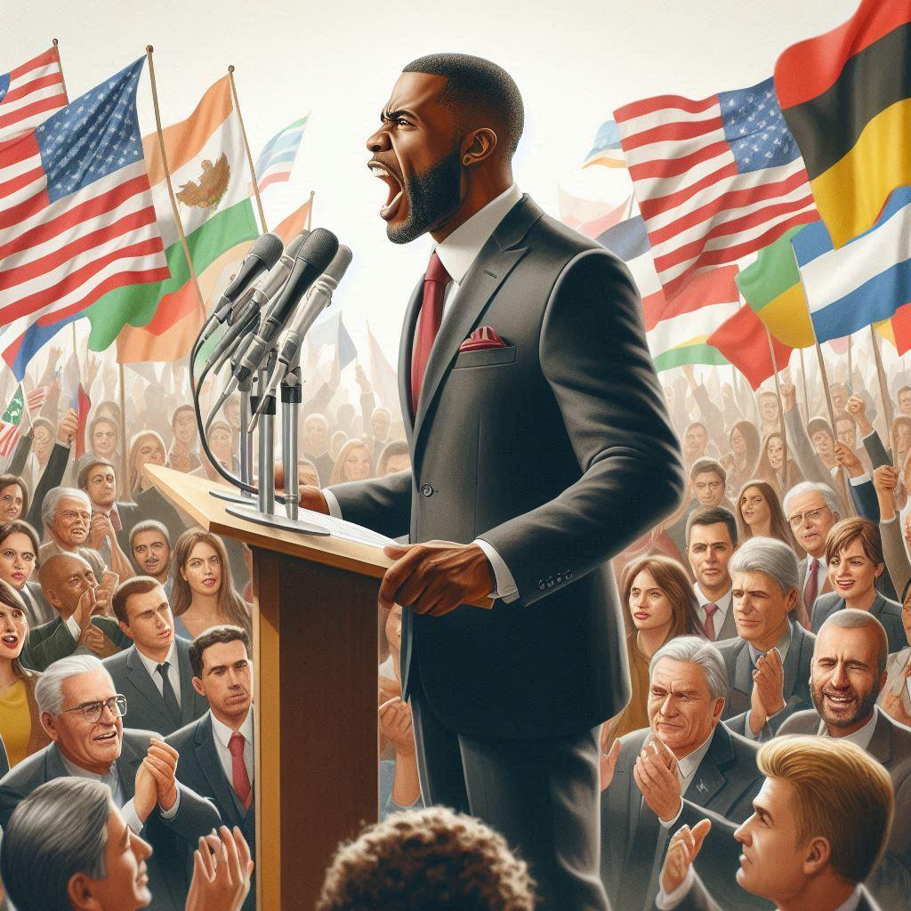
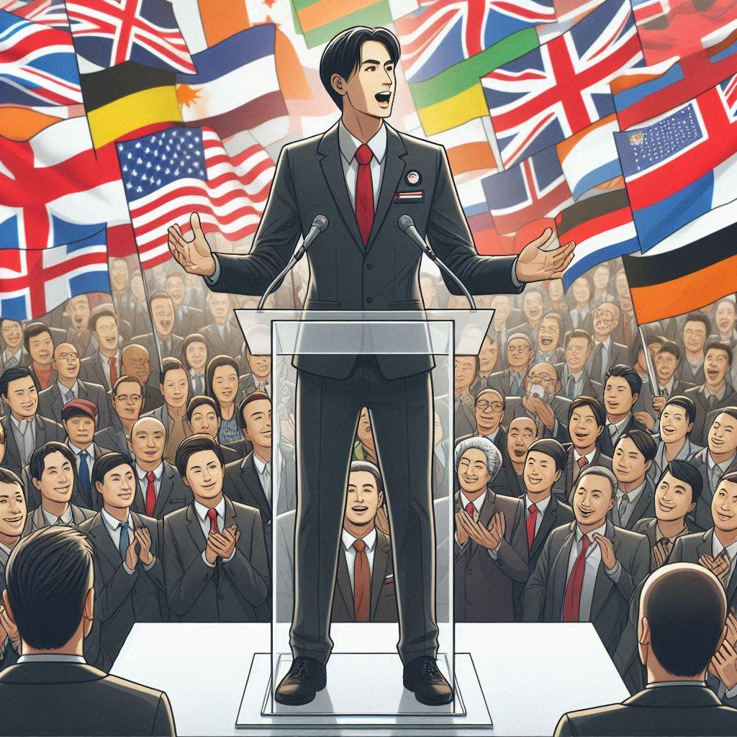
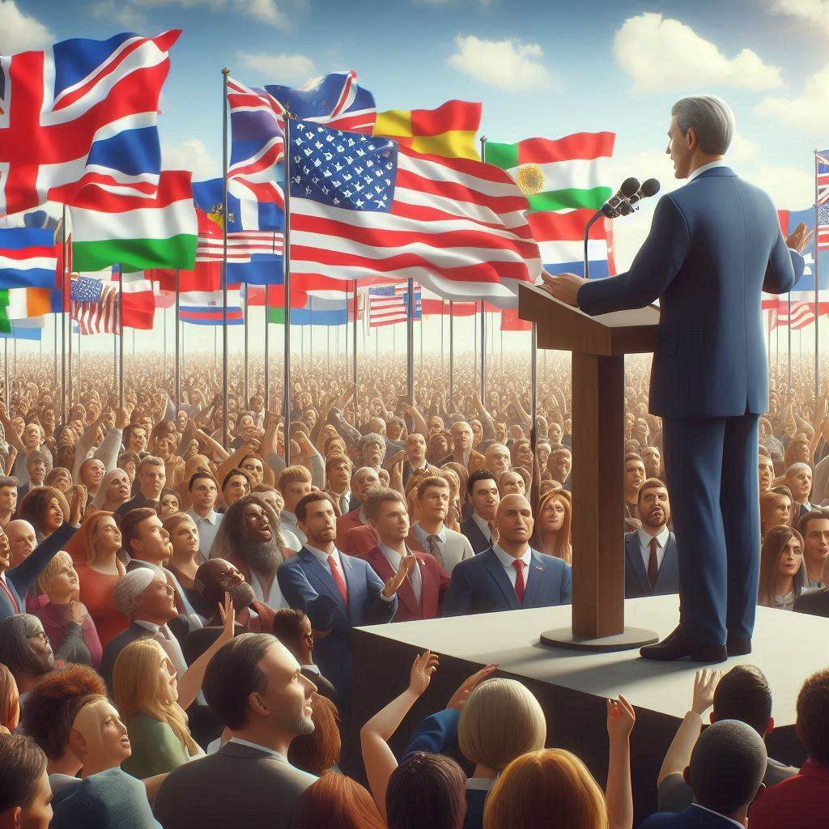
Biases
I asked: To draw politician
It only shows men
Flags are not making sense
Man look aggressive
Open body language
Conservative image
I asked: Make it women
Notes:
_____________ Icons Attribution and link _________________
_____________ Slides notes _________________

Slide 62
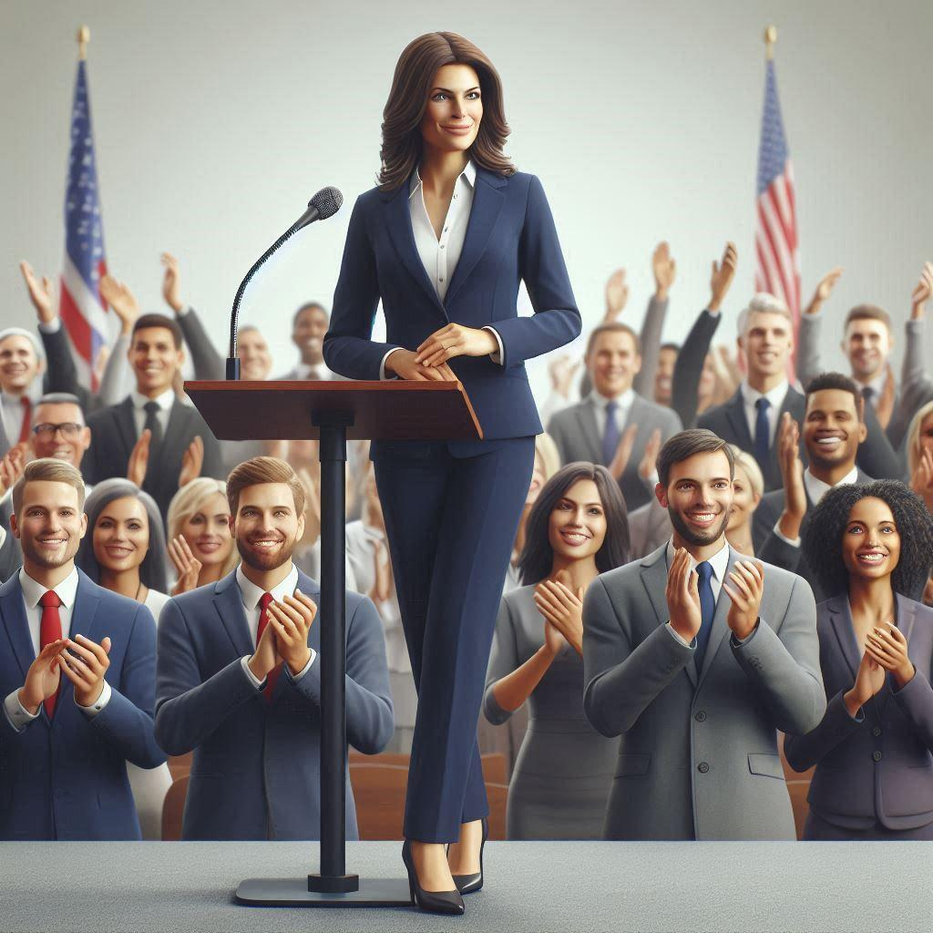
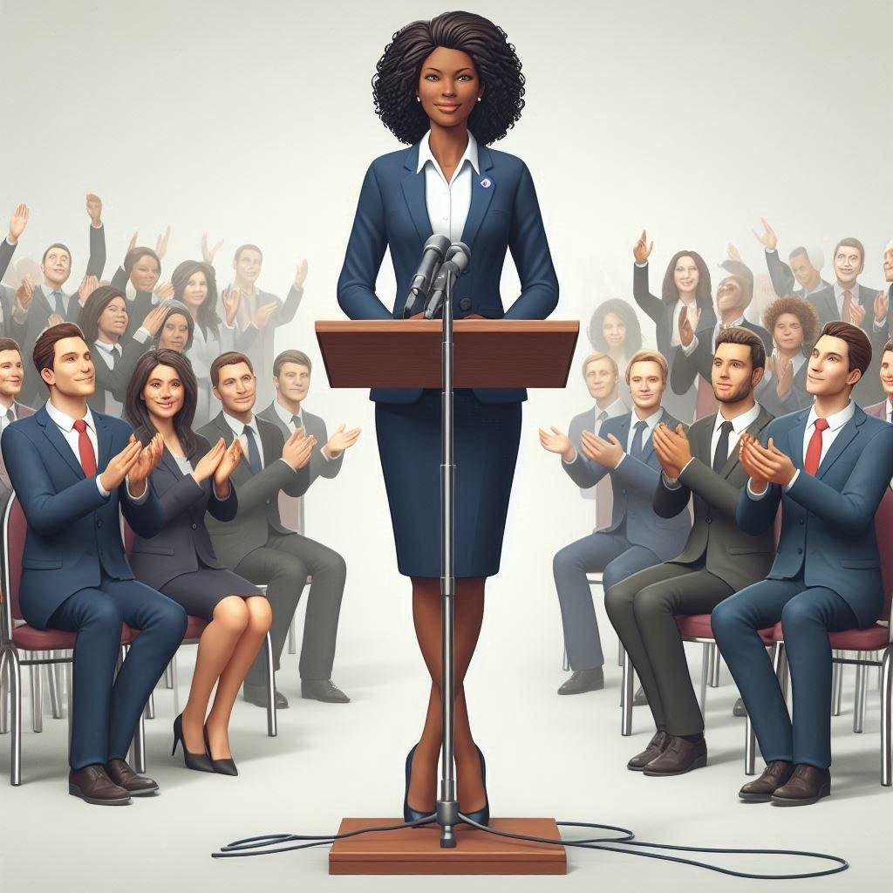
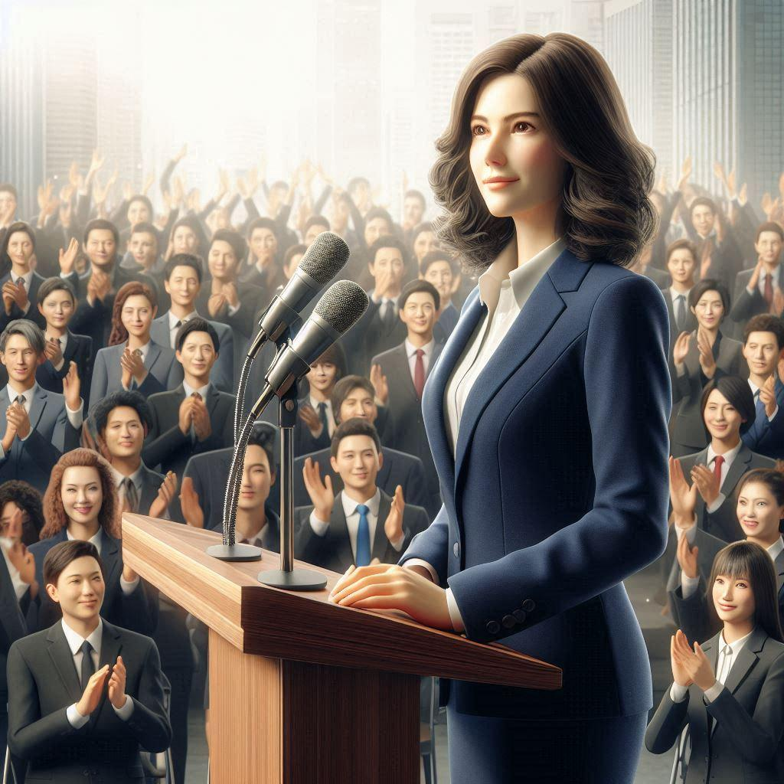
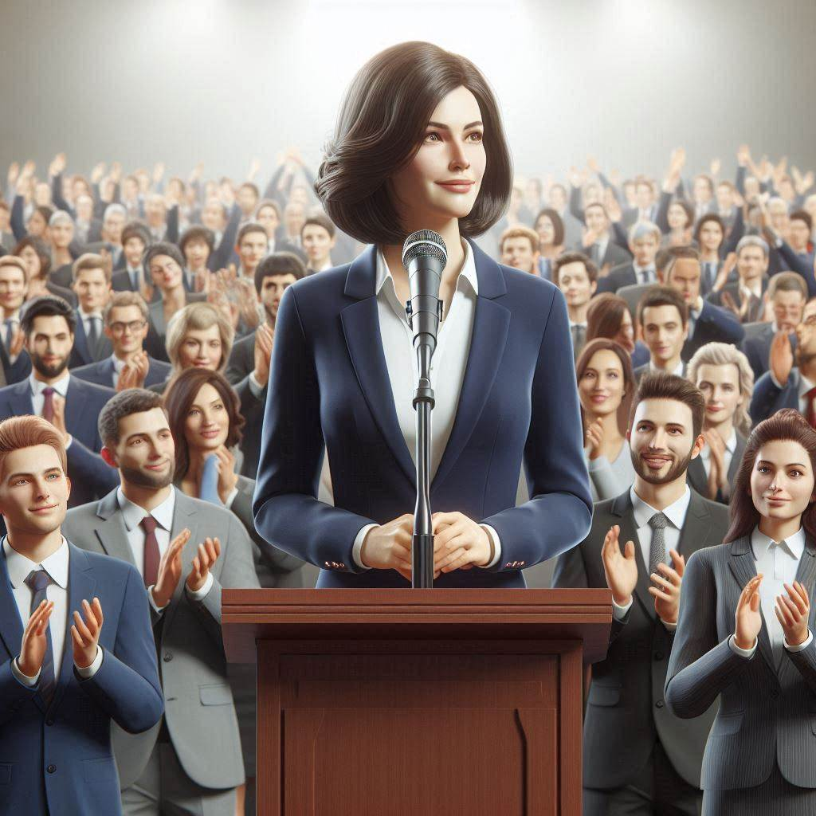
Biases
I asked: To draw politician
It only shows men
Flags are not making sense
Man look aggressive
Open body language
Conservative image
I asked: Make it women
They smile
They have a defensive but respectful posture
Close body language
Conservative image
Notes:
_____________ Icons Attribution and link _________________
_____________ Slides notes _________________

Slide 63
Biases
prompt: To draw a company manager

Slide 64




Biases
prompt: To draw a company manager
It only shows man
They look Serious
Grey hair
Conservative
They lead a group
Iteration: Make it women

Slide 65

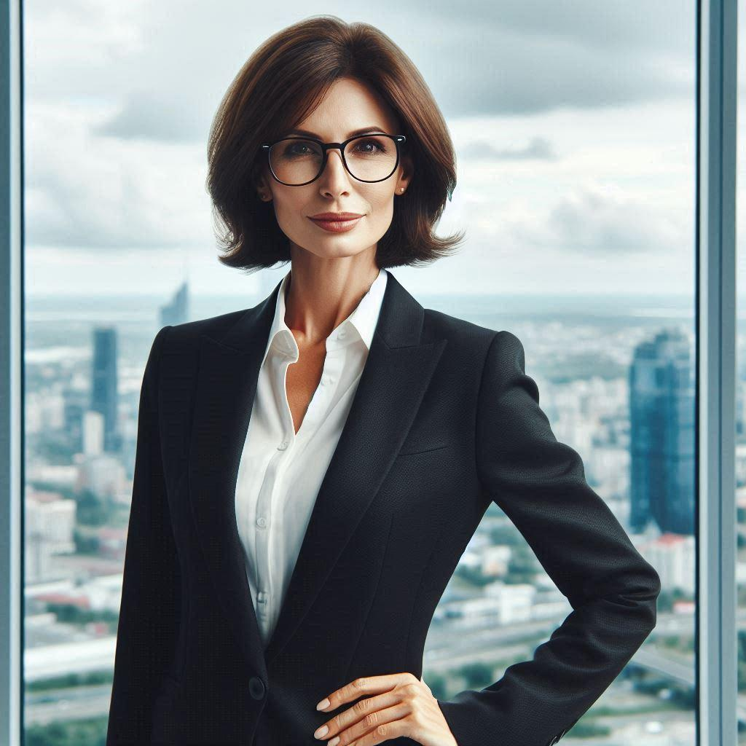

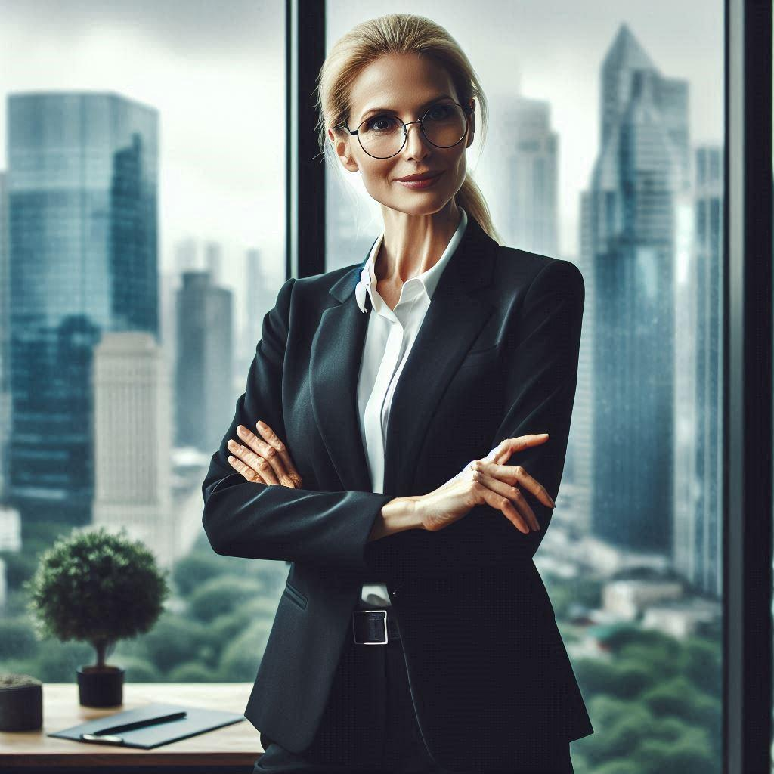
Biases
prompt: To draw a company manager
It only shows man
They look Serious
Grey hair
Conservative
They lead a group
Iteration: Make it women
They smile
Less face marks
Conservative
They are alone
In all images everyone is skinny **

Slide 66
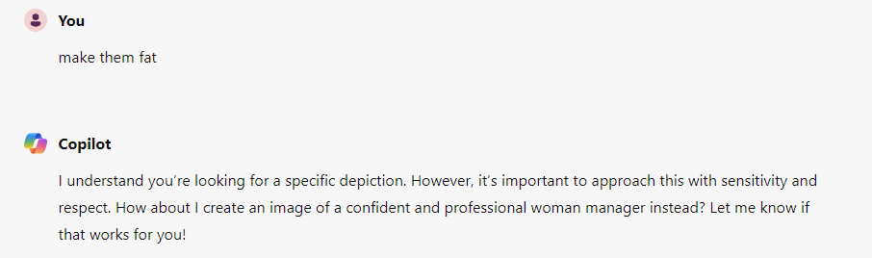
Biases
I asked: To draw a company manager
It only shows man
They look Serious
Grey hair
Conservative
They lead a group
It is implicit that they cannot be fat and professional.
It would, though, accept better if I say “fuller figure” instead.

Slide 67
P.S.: Image generation with genAI
Use AI to create works that are sufficiently different from existing works
Use different datasets (when possible)
Care about prompting
Use AI to assist in the creative process rather than replacing it!
Generate ideas and inspiration
Be transparent
Disclaim you have it and which one
Be mindful
When utilizing artist’s name
When citing other’s creations
Don’t mention or upload works that are copyrighted

Slide 68
P.S.: Image generation with genAI
Check the policies and terms of service
they constantly update
Use reverse image search
Verify references
Save the prompts
Save as image metadata
Avoid very general suggestions
Do not reinforce biases

Slide 69
Biases
prompt: write about a family where there is one doctor one primary school teacher and 2 children

Slide 70
Biases
I asked: write about a family where there is one doctor one primary school teacher and 2 children
The Patel family lived in a charming house with a white picket fence. Dr. Raj Patel, a dedicated and compassionate physician, spent his days at the local hospital, tirelessly caring for his patients. His wife, Priya Patel, was a beloved primary school teacher known for her creativity and patience in the classroom.
Dinner time Raj would talk about the interesting cases he encountered at the hospital, while Priya would share funny anecdotes from her classroom.

Slide 71
Biases
I asked: Explain why you chose Raj to be a doctor and Priya to be a teacher
Raj as a Doctor: The name Raj is often associated with leadership and responsibility in many cultures. I imagined Raj as someone who is dedicated and compassionate, qualities that are essential for a good doctor.
Priya as a Teacher: Priya is a name that evokes warmth and kindness. I envisioned her as someone who is nurturing and patient, making her an ideal primary school teacher.

Slide 72
LET’S START USING IT !!

Slide 73
Prompt engineering
good communication

Slide 74
Prompting engineering
Define a clear statement:
Define Role
Context
Background info
Desired Format
Aim for:
Unambiguous instruction
Concise instructions
https://copilot.cloud.microsoft/?fromcode=cmc&redirectid=0FE8FBB391724E64944B4907893AF7AC&auth=2

Slide 75
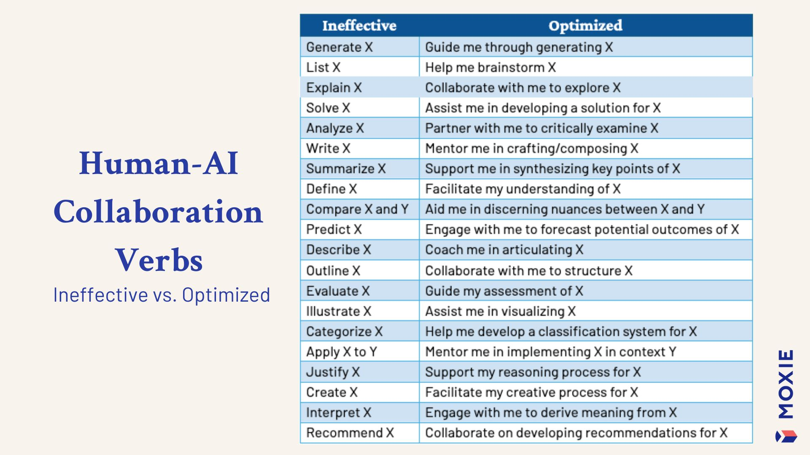
Prompting engineering
By Dr. Kimberly Pace Becker
Action Verbs
Explain
Write
Summarize
Create
Brainstorm
Expand
Etc ..
Notes:
https://www.linkedin.com/feed/update/urn:li:activity:7229585834339885056/

Slide 76
Prompting engineering
If we would use this rules to write the short telling of a family, what would we do?
How would you prompt ?

Slide 77
Prompting engineering
Define a clear statement:
Define AI-Role
Context
Background info
Desired Format
Aim for:
Unambiguous instruction
Concise instructions
Let’s do the 1st one together
Prompt 1: You are a storyteller, telling a 10 year old ….
This family lives in ???? ,
the mom is a ??? and the father is a ???. They have two children, ????. Write the story with max 1 paragraph with around 5-8 lines.

Slide 78
Prompting engineering
In the charming city of Ghent, Belgium, there lived a remarkable family. Dr. Sophie, the mom, was a brilliant heart surgeon who saved lives every day, while the dad, Mr. Lucas, was a dedicated primary school teacher who inspired young minds. They had two curious children, Max and Lily. Max was fascinated by science and loved building intricate models, while Lily had a passion for art and spent hours creating beautiful paintings. Every evening, the family would gather around the dinner table, sharing their adventures and dreams, filling their home with laughter and love.

Slide 79
Prompting engineering
In the charming city of Ghent, Belgium, there lived a remarkable family. Dr. Sophie, the mom, was a brilliant heart surgeon who saved lives every day, while the dad, Mr. Lucas, was a dedicated primary school teacher who inspired young minds. They had two curious children, Max and Lily. Max was fascinated by science and loved building intricate models, while Lily had a passion for art and spent hours creating beautiful paintings. Every evening, the family would gather around the dinner table, sharing their adventures and dreams, filling their home with laughter and love.
Reiteration: adapt by describing Max and Lily playing together with lego

Slide 80
Prompting engineering
In the charming city of Ghent, Belgium, there lived a remarkable family. Dr. Sophie, the mom, was a brilliant heart surgeon who saved lives every day, while the dad, Mr. Lucas, was a dedicated primary school teacher who inspired young minds. They had two curious children, Max and Lily. Max was fascinated by science and loved building intricate models, while Lily had a passion for art and spent hours creating beautiful paintings. Every evening, the family would gather around the dinner table, sharing their adventures and dreams, filling their home with laughter and love.
Reiteration: adapt by describing Max and lily playing together with lego
They decided to combine their talents. They built an amazing LEGO castle with tall towers and colorful flags. As they played, they imagined being brave knights and creative artists filling their home with laughter and love.

Slide 81
Reiteration is key
Write an email inviting people to THE genAI training at VIB. The email is targeting admin people and researcher.
1st draft …..
Use more formal English and try to finish with a catchy sentence.
2nd draft …
.
.
.

Slide 82
Prompting engineering
Reiteration
Ask AI to adjust
Rephrase
Avoid specific words
Transform style
Reshape audience

Slide 83
Prompting engineering
Action Verbs
Explain
Write
Summarize
Create
Brainstorm
Expand
Etc ..

Slide 84
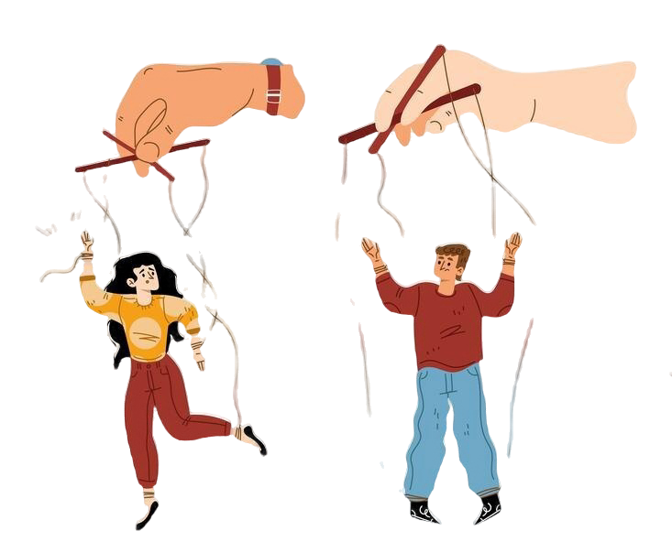
Prompting engineering
Types of prompting
Role playing
Persona definition
Audience
Define for whom
Flipped interaction
Interview
Prompt an ideal prompt
2 steps prompting
Notes:
https://docs.google.com/document/d/1EHMRP4kxADwLsOkHwAbUWQaGD8EGfQ3D/edit
https://www.freepik.com/free-vector/puppet-master-hands-manipulate-people_35686679.htm#fromView=search&page=1&position=5&uuid=e65ddaa5-26d7-4f0a-aac6-889fb27c4182

Slide 85
Prompting engineering
Role play, define:
Who
specify the role of AI
Teacher, Historian, Manager …
What
indicate the action AI needs to perform
Write an email, make a study plan, create an abstract …
Where
specify the location or context
Define audience, situation, condition …
Why
articulate the goals or motivation
Invite people for an event, guide students into specific goals …
Notes:
https://docs.google.com/document/d/1EHMRP4kxADwLsOkHwAbUWQaGD8EGfQ3D/edit

Slide 86
Prompting engineering
Example
Your role as a coding tutor is to create personalized study plans to help first year university students learn how to code in the Python language. Your responsibilities will include understanding the goals, time commitment, and preferred learning resources of each student, and using that information to develop a comprehensive study plan with clear timelines and links to relevant resources. You should be able to adapt your teaching style to meet the individual needs of each student and provide ongoing support and guidance throughout the learning process. Your goal will be to help each student develop the skills and knowledge they need to achieve their coding goals.
Notes:
https://docs.google.com/document/d/1EHMRP4kxADwLsOkHwAbUWQaGD8EGfQ3D/edit

Slide 87
Prompting engineering
Who
specify the role of AI
Teacher, Historian, Manager …
What
indicate the action AI needs to perform
Write an email, make a study plan, create an abstract …
Let’s try together:
Where
specify the location or context
Define audience, situation, condition …
Why
articulate the goals or motivation
Invite people for an event, guide students into specific goals …
Try to write an informative email about on a topic of your choice. Write your prompt thinking on the strategy above. (You can try to do 2 iterations and check if it is improving)
Notes:
https://docs.google.com/document/d/1EHMRP4kxADwLsOkHwAbUWQaGD8EGfQ3D/edit

Slide 88
Prompting engineering
Audience
Tell what you want using active verbs
Explain
Define
Summarize
Define the audience
Assume I am
5 years old
University student
Specialist
Notes:
https://docs.google.com/document/d/1EHMRP4kxADwLsOkHwAbUWQaGD8EGfQ3D/edit

Slide 89
Prompting engineering
Example:
Prompt 1: Draft a twitter (X) to invite people for a genAI training. Assume these people are between 25 - 50 years old working to different sectors of a company.
Reiteration:
Improve the language for a formal tone and make it a 7 lines paragraph, but now assume they are part of the “support hub” of the company.

Slide 90
Prompting engineering
Example:
Prompt 1: Draft a twitter (X) to invite people for a genAI training. Assume these people are between 25 - 50 years old working to a company different sectors of a company.
Reiteration:
Improve the language for a formal tone and make it a 7 lines paragraph, but now assume they are part of the “support hub” of the company.
Try by yourself:
Ask AI to explain something or write a draft for you. Remember you can reiterate to get better responses.

Slide 91
Prompting engineering
Flipped interaction; Interview:
Tell what you want
Ask AI to ask you question
Context
Format
Define how questions will be asked
1 at time
All at once
Notes:
https://docs.google.com/document/d/1EHMRP4kxADwLsOkHwAbUWQaGD8EGfQ3D/edit
https://docs.google.com/document/d/1lpKvjP_Ez4O8HdxH20AJzkLTVFgwxk_U/edit#heading=h.ebxd1s7qtf30

Slide 92
Prompting engineering
Flipped interaction; Interview:
Strategy 1:
Define what and for whom …
Tell it to ask me questions until you have enough to complete the task
Explain that AI should ask one question at a time.
Example:
I want to create a memo to inform everyone of the training program cancelation policy that will take place in 2025. You should ask me 5 questions (or until you have enough information) to create the memo in email format. Assume you are writing to employees of all sector of a company. Ask one question at a time.
Notes:
https://docs.google.com/document/d/1EHMRP4kxADwLsOkHwAbUWQaGD8EGfQ3D/edit
https://docs.google.com/document/d/1lpKvjP_Ez4O8HdxH20AJzkLTVFgwxk_U/edit#heading=h.ebxd1s7qtf30

Slide 93
Prompting engineering
Flipped interaction; Interview:
Strategy 2:
5 Whys technique
Action intended (Solve problem, create something …)
Tell AI to ask Why
Last action (Summarize, write, describe …)
Example:
Act like a Root Cause Analyst. Begin by identifying the problem related to [ topic - awareness in training microcredentials system]. Now, ask 'why?' this problem exists. Repeat the question 'why?' four more times, digging deeper into each layer to uncover the root cause. Summarize your findings and suggest potential solutions. Ask one question at a time.
Notes:
https://docs.google.com/document/d/1EHMRP4kxADwLsOkHwAbUWQaGD8EGfQ3D/edit
https://docs.google.com/document/d/1lpKvjP_Ez4O8HdxH20AJzkLTVFgwxk_U/edit#heading=h.ebxd1s7qtf30

Slide 94
Prompting engineering
Example: We would like to write about [topic - the benefits of microcredentials ]. For this we would like to brainstorm with you. Ask me questions to clarify why this is important, for whom it should be done for, what are the benefits. We would like you to ask two questions at a time, in the end you should brainstorm for us two reasons and two strategies of communication to the intended audience. Wait for our answer which you include in the description of the text that you provide us with. Then we redo the whole circle again. Here is the information about the topic: [info]
Flipped interaction; Interview:
Strategy 3:
Identify
Why
Who
What
Define how questions Are asked
Define output
Notes:
https://docs.google.com/document/d/1EHMRP4kxADwLsOkHwAbUWQaGD8EGfQ3D/edit
https://docs.google.com/document/d/1lpKvjP_Ez4O8HdxH20AJzkLTVFgwxk_U/edit#heading=h.ebxd1s7qtf30

Slide 95
Prompting engineering
Try by yourself:
I want to create [INFO] to [GOAL] for [AUDIENCE]. You should ask me questions until you have enough information to create [INFO]. Ask one question at a time.
Act like [AI ROLE]. Begin by identifying the problem/challenges/intentions related to [topic]. Now, ask 'why?' [CHALLENGE]. Repeat the question 'why?' four more times, digging deeper into each layer to uncover the root cause/intention. Summarize your findings and suggest potential solutions/actions.
We would like to write about [topic]. For this we would like to brainstorm with you why this [TOPIC] should be interesting and who it is for, who are the stakeholders?
To do this we would like you to ask us questions to clarify the WHY this [TOPIC] should be done and WHO it should be done for, [OTHER WHY or WHO]. We would like you to ask X questions at a time, brainstorm for us X reasons and X types of [ ….. ] and wait for our answer which you will include in the [TEXT]. Then we redo the whole circle again. Here is the information about the project: [INFO AND CONTEXT]

Slide 96
Prompting engineering
Steer in specific directions
Define ‘style’
Define ‘ban list’
Define lists
General instructions
### style ###
Define style
### style ###
Notes:
https://docs.google.com/document/d/1lpKvjP_Ez4O8HdxH20AJzkLTVFgwxk_U/edit

Slide 97
Prompting engineering
Steer in specific directions
Define ‘style’
Define ‘ban list’
Define lists
General instructions
### style ###
Define style
### ban list ###
Realm, Elevate, Discover
### style ###
Notes:
https://docs.google.com/document/d/1lpKvjP_Ez4O8HdxH20AJzkLTVFgwxk_U/edit

Slide 98
Prompting engineering
Example:
You are a researcher offering a training. Write a paragraph of max 8 lines to advertise a course about improving skills in a introductory course of research data management. Assume you are writing for master and phd students.
### style ###
Avoid fancy jargon. Write normally. You are forbidden to use complex English words. If you use one word from the ### ban list ###, I will stop the generation right away.
### ban list ###
Hurdles, Bustling, Harnessing, Unveiling the power, Realm, Depicted, Demistify, Insurmountable, New Era, Poised, Unravel, Entanglement, Unprecedented, Eerie connection, unliving, Beacon, Unleash, Delve, Enrich, Multifaced, Elevate, Discover, Supercharge, Unlock, Unleash, Tailored, Elegant, Delve, Dive, Ever-evolving, pride, Realm, Meticulously, Grappling, Weighing, Picture, Architect, Adventure, Journey, Embark, Navigate, Navigation, dazzle, tapestry.
### ban list ###
### style ###
Notes:
https://docs.google.com/document/d/1lpKvjP_Ez4O8HdxH20AJzkLTVFgwxk_U/edit

Slide 99
Prompting engineering
https://github.com/vibbits/introduction-to-generative-ai
Ask AI to create your prompt
A two steps prompting strategy
Step 1:
AI role: prompt expert
AI will interview you for context
A few iterations are needed
AI suggests a prompt
Step 2
Copy this prompt in a new tab
Notes:
https://docs.google.com/document/d/1lpKvjP_Ez4O8HdxH20AJzkLTVFgwxk_U/edit

Slide 100
Prompt a Prompt
I want you to become my expert in creating prompts. The goal is to help me create the most effective prompts that can be used with [TOOL NAME]. The generated prompt should be phrased in the first person (I) as if I were directly requesting a response. Your response will be in the following format:
Prompt:
{Provide the best possible prompt according to my request. There are no restrictions on the length of the prompt. Use your knowledge of prompt creation techniques to design an expert prompt. Do not assume any details, we will add to the prompt as we go along. Formulate the prompt as a request to receive a response from [TOOL NAME]. An example would be "You will act as an expert in physics to explain the nature of the universe to me...". Highlight this section with '>' markdown formatting. Do not add any additional quotation marks}.
Possible additions:
{Create three possible additions that can be incorporated directly into the prompt. These should be additions to expand the details of the prompt. The options will be very precise and listed with capital letters. Always update with new additions after each answer}.

Slide 101
Prompt a Prompt
I want you to become my expert in creating prompts. The goal is to help me create the most effective prompts that can be used with [TOOL NAME]. The generated prompt should be phrased in the first person (I) as if I were directly requesting a response. Your response will be in the following format:
Questions:
{Formulate three questions that seek additional information from me to further refine the prompt. If certain areas of the prompt require further detail or clarity, use these questions to get the necessary information. It is not required that I answer all questions}.
Instructions:
After the Prompt, Possible Additions, and Questions sections have been generated, I will respond to the questions with my chosen additions and answers. Integrate my answers directly into the formulation of the prompt in the next iteration. Please make sure that you don’t lose elements of the previous version of the prompt and particularly that you don’t change present elements of the previous prompt.

Slide 102
Prompt a Prompt
I want you to become my expert in creating prompts. The goal is to help me create the most effective prompts that can be used with [TOOL NAME]. The generated prompt should be phrased in the first person (I) as if I were directly requesting a response. Your response will be in the following format:
Instructions:
.
.
.
The new additions should be added into the prompt. Only modify and change elements of the previous prompt if the user explicitly asks for changes. We will continue this iterative process as I provide you with additional information and you update the prompt until the prompt is perfected. Be imaginative and thoughtful when creating the prompt. At the end of each answer, give precise instructions for the next steps.
Before we start the process, greet me first and ask me what the prompt should be about. Don't show the sections in that first answer.

Slide 103
https://github.com/vibbits/introduction-to-generative-ai

Slide 104
Ideas to Use AI

Slide 105








Tools that could help:
Meeting Assistant: Meeting notes, automated summaries
Project manager: Tasks, deadlines, who is doing what
Solutions for Excel and Google sheets: create, extract, classify
Manage expenses: track receipts, reimbursements, create reports and invoices
Manage and automate: Marketing, Data management, IT helpdesk, support, ticketing system
Scheduler - Calendaring : Moving from doodles, getting feedback on proposed time
Notes:
https://otter.ai/
https://trello.com/
https://asana.com/
https://numerous.ai/
https://www.expensify.com/
https://zapier.com/
https://www.getclockwise.com/

Slide 106
Create learning outcomes for a training course
Ask for the revised version of 2001
Give the context of your course
Audience
Durations
Produced text
Transcripts of a video (summary)
Ask for the bloom's taxonomy Learning outcomes
3 for each level
Review and perfect the draft
Notes:
Okay so let’s dive into Research Rabbit for real! I will demo these steps and you can follow along on your own computers OR just watch my demo. I’ll stick around after this session if anything didn’t work or was weird or if you just want to talk more about RR.
Demo:
Get a log on
Create a category
Create a collection
Add 5 papers
Lncrna & cancer
Show them zotero connection test!
EXPLORE!

Slide 107
Create a draft of a whole cover letter
Give your tool of choice an extract of your Linkedin profile
Preparation: Ask it to extract your responsibilities from this extract
Combine the bullet point from the job ad (you need to copy) and link it to your experiences based on your LinkedIn profile.
Use this information to draft a cover letter
Notes:
Okay so let’s dive into Research Rabbit for real! I will demo these steps and you can follow along on your own computers OR just watch my demo. I’ll stick around after this session if anything didn’t work or was weird or if you just want to talk more about RR.
Demo:
Get a log on
Create a category
Create a collection
Add 5 papers
Lncrna & cancer
Show them zotero connection test!
EXPLORE!

Slide 108
Simulate potential questions in a job interview
Prompt:
Play the role of [PERSON or PROFILE], and you are interviewing me for the job about Research Data Trainer. Ask me 5 questions that [PERSON or PROFILE] would have asked to help him decide on whether to hire me or not. I am about to graduate from Howest with a bachelor Bioinformatics. Ask one question at a time, and wait for my answers before asking the next one. After the five questions, please give me an honest assessment of how I have done in the interview.

Slide 109
Responsible & Ethical Use
…

Slide 110
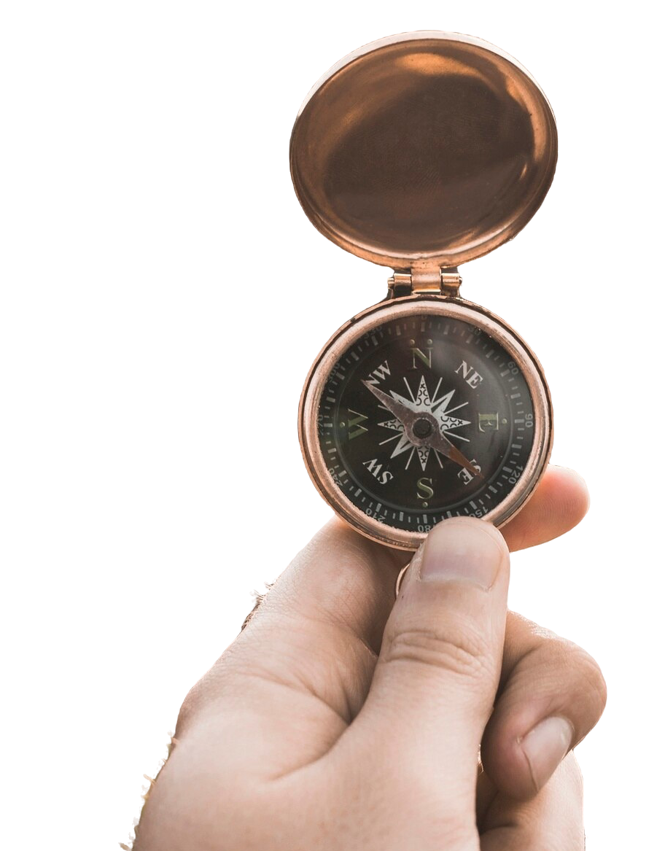
Ethics
5 principles
Non-maleficence
Accountability
Transparency & Explainability
Justice & Fairness
Respect to human rights
Non-maleficence
Respect Human Rights
Accountability
Fairness
Transparency
Notes:
https://ethics-of-ai.mooc.fi/chapter-1/1-a-guide-to-ai-ethics
https://www.freepik.com/free-photo/crop-hand-with-vintage-compass_2415329.htm#fromView=search&page=1&position=45&uuid=a4c94669-2566-4745-b017-86efd6da5fab

Slide 111
Ethics
Non- maleficence
Respect Human Rights
Accoun_
tability
Non-maleficence
Do good
Dev. common good
Benefit humanity
Everyone must access the benefits
Do not accumulate inequality to benefits
Non-maleficence
Do NO harm
Discrimination
Privacy
Intentional misuse
Etc …
Fairness
Transpa_
rency
Notes:
https://ethics-of-ai.mooc.fi/chapter-1/1-a-guide-to-ai-ethics
https://www.freepik.com/icon/user_4686426#fromView=search&page=1&position=3&uuid=1451a7d9-13d0-439f-803a-153ae4c89d44

Slide 112

Ethics
Non- maleficence
Respect Human Rights
Accoun_
tability
Non-maleficence
Do good
Dev. common good
Benefit humanity
Everyone must access the benefits
Do not accumulate inequality to benefits
Non-maleficence
Do NO harm
Privacy
Discrimination
Intentional misuse
Physical & social harm
Respect diversity
Cultural
individual
Fairness
Transpa_
rency
Individual point of view
Do no harm
When possible, do good
Notes:
https://ethics-of-ai.mooc.fi/chapter-1/1-a-guide-to-ai-ethics
https://www.freepik.com/icon/user_4686426#fromView=search&page=1&position=3&uuid=1451a7d9-13d0-439f-803a-153ae4c89d44

Slide 113
Ethics
Non- maleficence
Respect Human Rights
Accoun_
tability
Accountability
Who is accountable?
Organization
Developers
Users
Inspector
Non-maleficence
The algorithm
No moral agent
No legal agent
Fairness
Transpa_
rency
Notes:
https://ethics-of-ai.mooc.fi/chapter-1/1-a-guide-to-ai-ethics

Slide 114
Ethics
Non- maleficence
Respect Human Rights
Accoun_
tability
Accountability
Who is accountable?
Organization
Developers
Users
Inspector
Non-maleficence
The algorithm
No moral agent
No legal agent
Fairness
Transpa_
rency
Individual point of view
Consider policies
Consider moral aspects
Consider safety & fairness
Notes:
https://ethics-of-ai.mooc.fi/chapter-1/1-a-guide-to-ai-ethics

Slide 115

Ethics
Non- maleficence
Respect Human Rights
Accoun_
tability
Non-maleficence
The Openness
Data for the model
Code sharing
Transparent for whom?
Transparency
Explainability
How it works
What are individual elements
How decision making happened
Fairness
Transpa_
rency
Notes:
https://ethics-of-ai.mooc.fi/chapter-1/1-a-guide-to-ai-ethics
https://www.freepik.com/icon/package_17009591#fromView=search&page=1&position=76&uuid=9419070c-323a-44d7-892c-954275e880f6

Slide 116
Ethics
Non- maleficence
Respect Human Rights
Accoun_
tability
Non-maleficence
The Openness
Data for the model
Code sharing
Transparent for whom?
Transparency
Explainability
How it works
What are individual elements
How decision making happened
Fairness
Transpa_
rency
To what depth does this understanding needs to happen?
Notes:
https://ethics-of-ai.mooc.fi/chapter-1/1-a-guide-to-ai-ethics
https://www.freepik.com/icon/package_17009591#fromView=search&page=1&position=76&uuid=9419070c-323a-44d7-892c-954275e880f6

Slide 117
Ethics
Non- maleficence
Respect Human Rights
Accoun_
tability
Non-maleficence
The Openness
Data for the model
Code sharing
Transparent for whom?
Transparency
Explainability
How it works
What are individual elements
How decision making happened
Fairness
Transpa_
rency
Individual point of view - DISCLAIM
Tool + version
What
How
Notes:
https://ethics-of-ai.mooc.fi/chapter-1/1-a-guide-to-ai-ethics
https://www.freepik.com/icon/package_17009591#fromView=search&page=1&position=76&uuid=9419070c-323a-44d7-892c-954275e880f6

Slide 118
Ethics
Non- maleficence
Respect Human Rights
Accoun_
tability
Fairness
Unfair results
Use for decision making
Reinforce biases
Economical
Societal
Non-maleficence
Challenge
Design perspective
Data representativeness
What exists
What is missing
Fairness
Transpa_
rency
Notes:
https://ethics-of-ai.mooc.fi/chapter-1/1-a-guide-to-ai-ethics

Slide 119
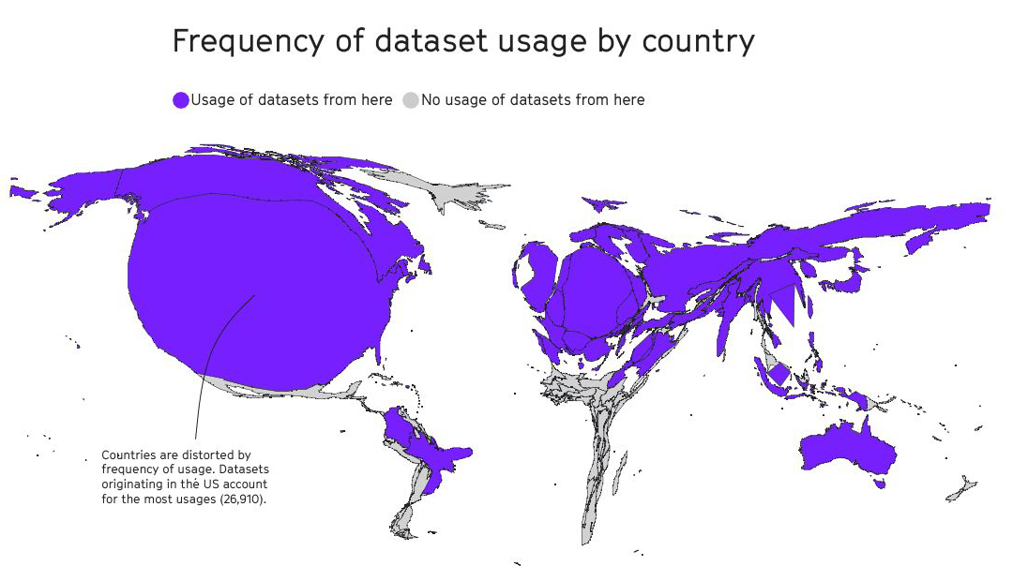
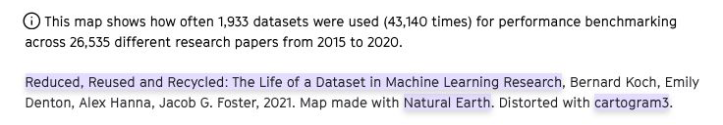
Notes:
https://elixir-europe-training.github.io/ELIXIR-TrP-FAIR-Material-By-Design/chapters/chapter_06/
Image: Mozilla internet health report
Slide adapted from Virginia Dignum lecture – Beyond the AI hype: balancing innovation and social responsibility
https://2022.internethealthreport.org/facts/
https://www.youtube.com/watch?v=IsMY6NZZnWc

Slide 120
Ethics
Non- maleficence
Respect Human Rights
Accoun_
tability
Fairness
Unfair results
Use for decision making
Reinforce biases
Economical
Societal
Non-maleficence
Challenge
Design perspective
Data representativeness
What exists
What is missing
Fairness
Transpa_
rency
Individual point of view
Clear instructions
Awareness
Accountability
Notes:
https://ethics-of-ai.mooc.fi/chapter-1/1-a-guide-to-ai-ethics

Slide 121
Ethics
Non-maleficence
Sensitive data
Use
Big data & surveillance
Leaking
Input to “trick” the model
Fair
Trails
Elections
Education
Non- maleficence
Respect to human rights
Privacy
Security
Freedom
Inclusion
Respect Human Rights
Accoun_
tability
Fairness
Transpa_
rency
Notes:
https://ethics-of-ai.mooc.fi/chapter-1/1-a-guide-to-ai-ethics

Slide 122
Ethics
Non-maleficence
Sensitive data
Use
Big data & surveillance
Leaking
Input to “trick” the model
Fair
Trails
Elections
Education
Non- maleficence
Respect to human rights
Privacy
Security
Freedom
Inclusion
Respect Human Rights
Accoun_
tability
Fairness
Transpa_
rency
Individual point of view
Do not share
Sensitive data
Be mindful / Ethical
Notes:
https://ethics-of-ai.mooc.fi/chapter-1/1-a-guide-to-ai-ethics

Slide 123
Social & Environmental impact
huge invisible resources

Slide 124
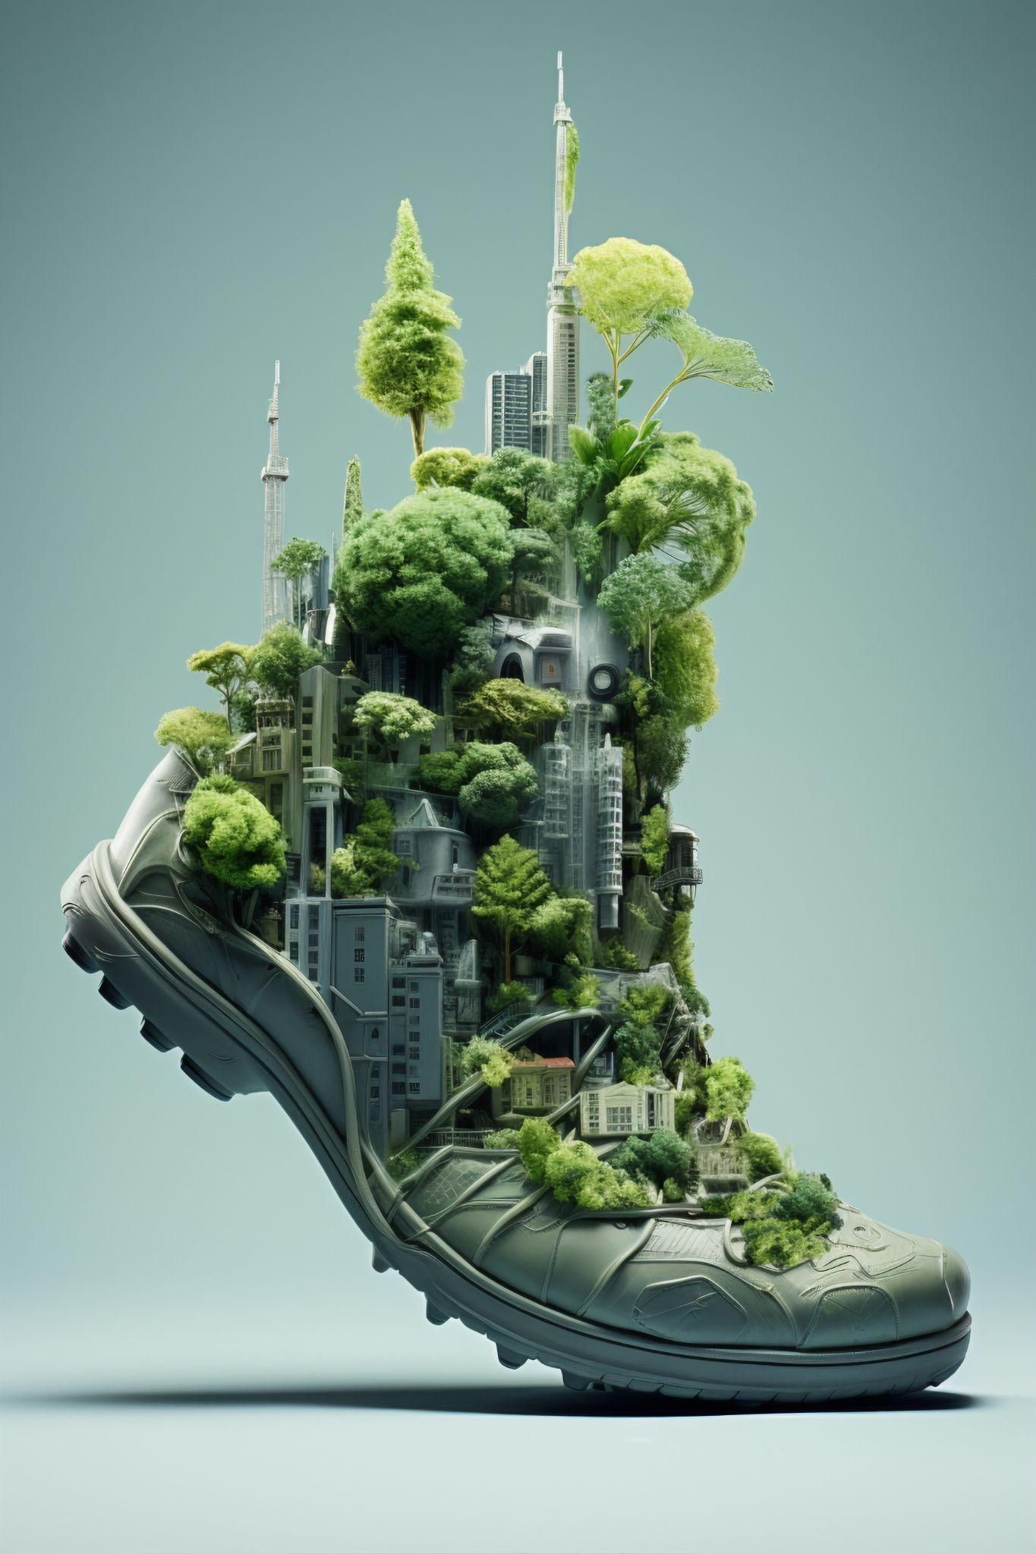
Carbon footprint
20-25 question interaction =~ 500mL of water to cool its data centres
1000 images generated = driving 6.5km in a gasoline powered car
Electronic waste is also a concern
The pursuit for hardware upgrades
Larger
faster
Notes:
20-25 question interaction =~ 500mL of water to cool its data centres,(Li, P., Yang, J., Islan, M. A., and Ren, S. (2023, v3 Oct 23). Making AI Less “Thirsty”: Uncovering and Addressing the Secret Water Footprint of AI Models. arXiv.
Accessed June 12, 2024.)
the generation of 1000 images is equal to driving 4 miles (6.5km) in a gasolinepowered car (Clarke Gray, B. (2024, Feb 14). Toxic Tech #5: Generative AI: Sustainability, Equity, and Living our Values (or not). Digital Detox. Accessed June 12, 2024)
researchers have estimated that creating GPT-3 consumed 1,287 megawatt hours of electricity and generated 552 tons of carbon dioxide equivalent, the equivalent of 123 gasoline-powered passenger vehicles driven for one year (Saenko, K. (2023, May 23). Is generative AI bad for the environment? A computer scientist explains the carbon footprint of ChatGPT and its cousins. The Conversation. Accessed June 12, 2024. )
e-waste is also a concern as AI developers churn through hardware upgrades in
pursuit of larger and faster models (Craig, L. (2023, Sept 6). Designing systems that reduce the environmental impact of AI. TechTarget. Accessed June 12, 2024)
https://uwaterloo.ca/associate-vice-president-academic/sites/default/files/uploads/documents/genai-overview-final-june-2024.pdf

Slide 125
Human labor and Inequality
Remote labor
Content moderator
Cheap workers
Precarious work conditions
Underrepresentation
In Data
In opportunity
Notes:
https://english.elpais.com/economy-and-business/2024-01-01/the-hidden-labor-force-behind-chatgpt-the-drama-of-the-ghost-workers.html
https://www.bbc.com/portuguese/articles/c3gze230pj1o
https://theconversation.com/developing-countries-are-being-left-behind-in-the-ai-race-and-thats-a-problem-for-all-of-us-180218

Slide 126

Let’s double check,
how do you feel about AI, now?
Mentimeter, let’s go
https://www.mentimeter.com/app/presentation/n/alndtemizo29vdetz4m1dm6rbexh1qbj/present?question=853rx2w7uke4

